Slide 1
Desktop Environment Setup
Lei CDL Yu

Slide 2
Overview

Slide 3
Desktop Source Structure Overview
z/OSMF Build
RTC
GITHUB
*.js
*.jsp
*.html
*.java
*.ts
*.html

Slide 4
Why we used github instead of RTC to store angular code？
GitHubDesktop can indicate code change easily.
IDE can integrate with github automatically.
Github contains many open good projects.
Compile angular code will generate *.js files which indicate the changed files in RTC.

Slide 5
Angular Environment Setup

Slide 6
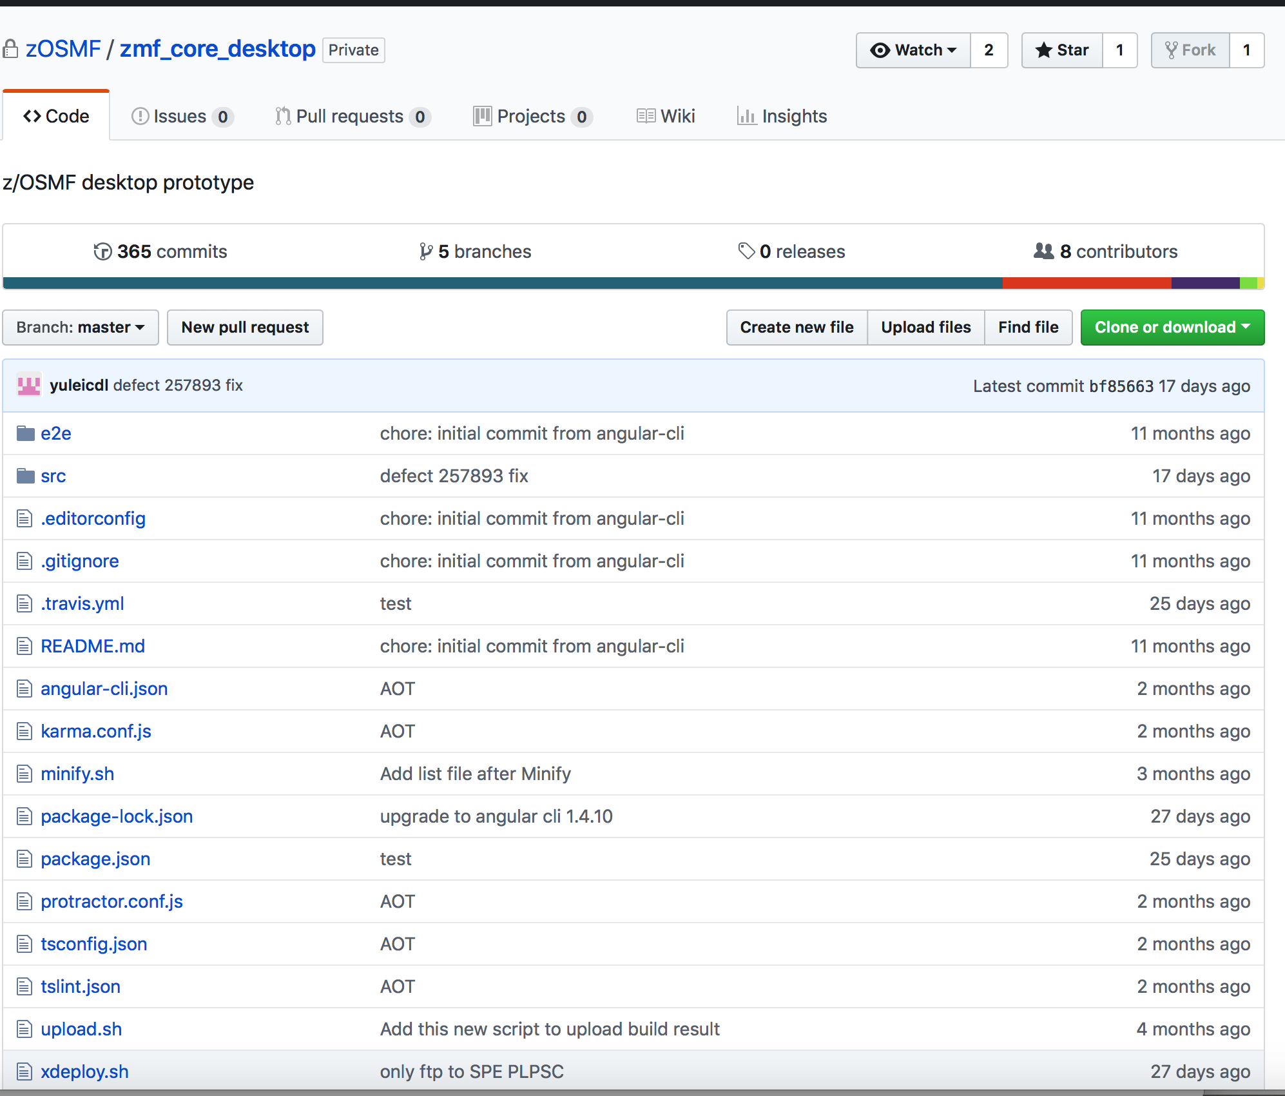
Code in Angular
https://github.ibm.com/zOSMF/zmf_core_desktop

Slide 7
Download github desktop
https://na.artifactory.swg-devops.com/artifactory/webapp/#/home

Slide 8
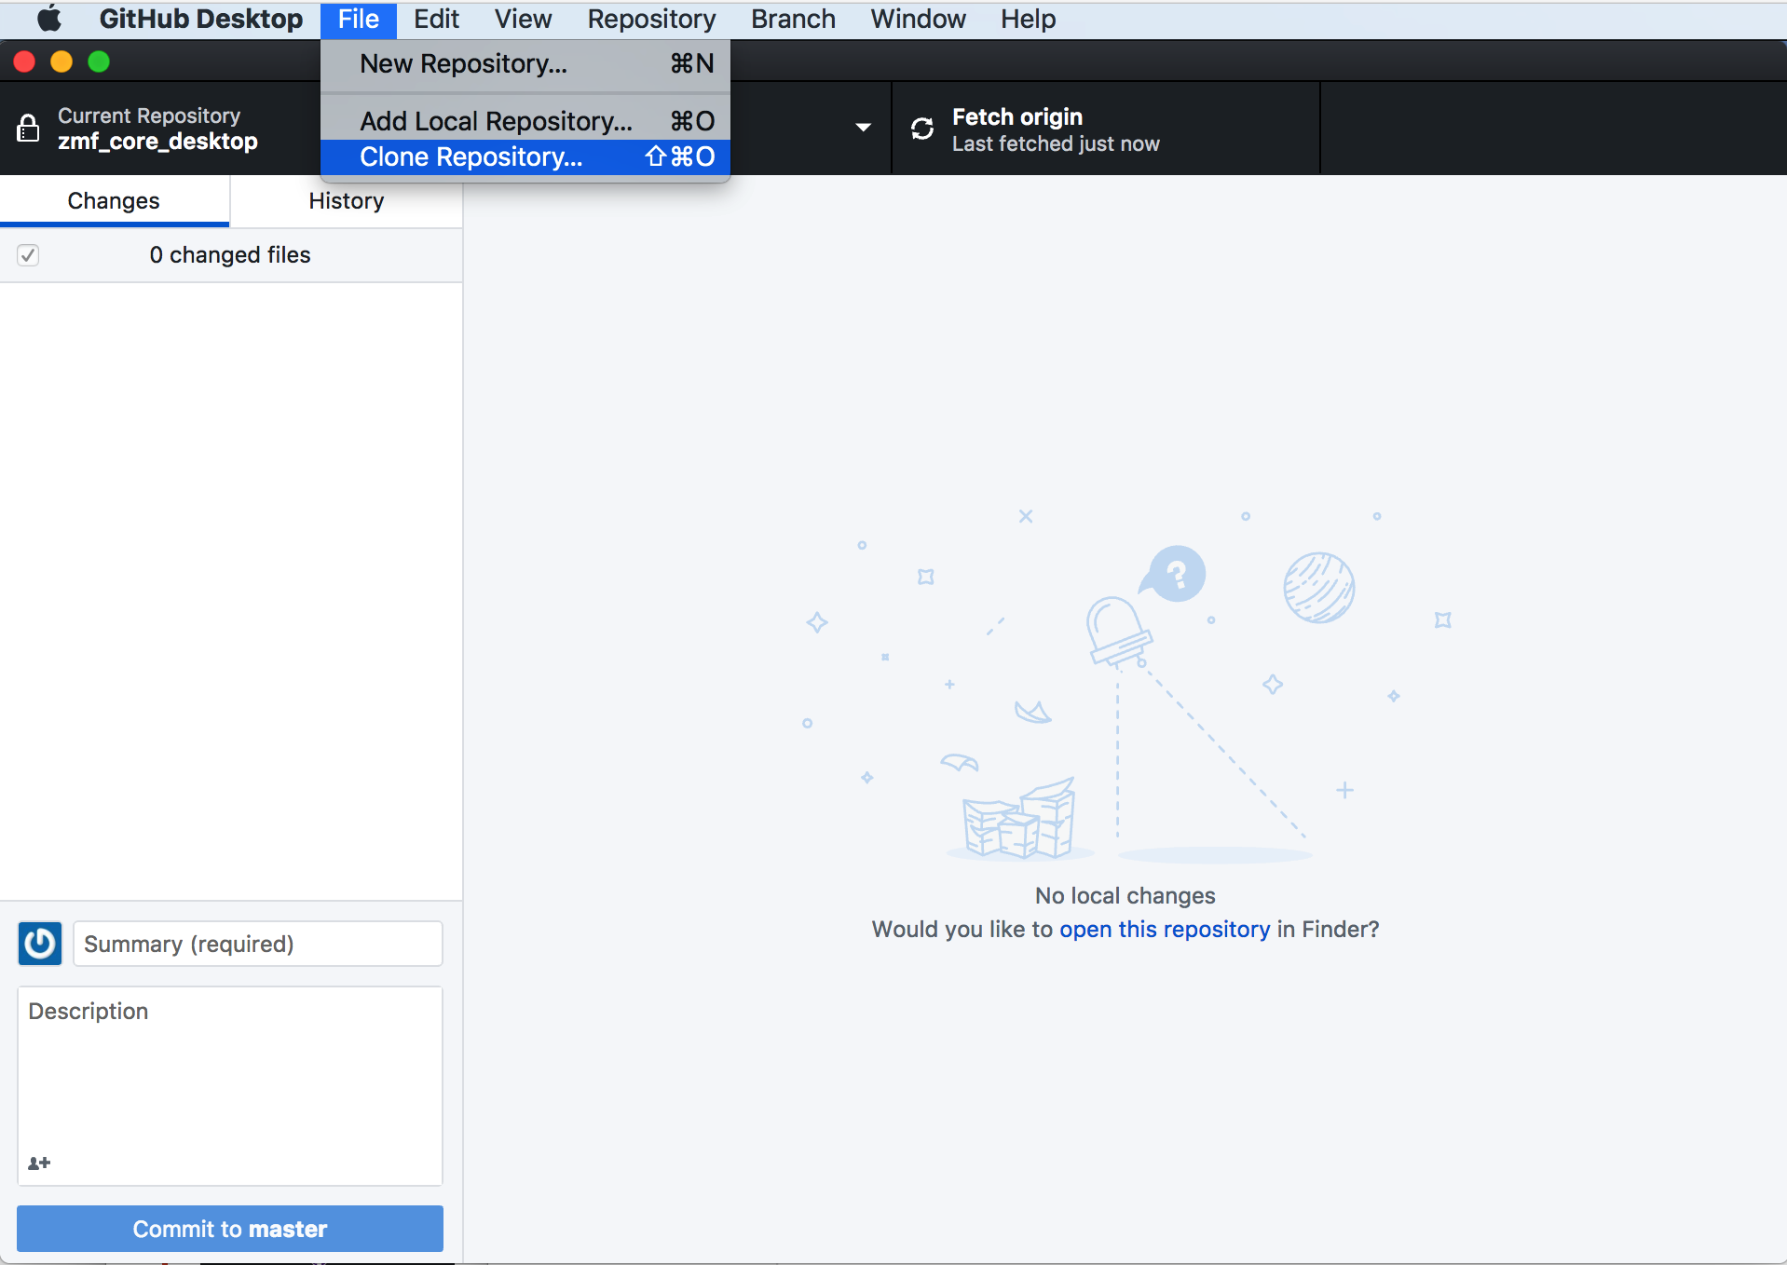
Clone Angular code to local

Slide 9
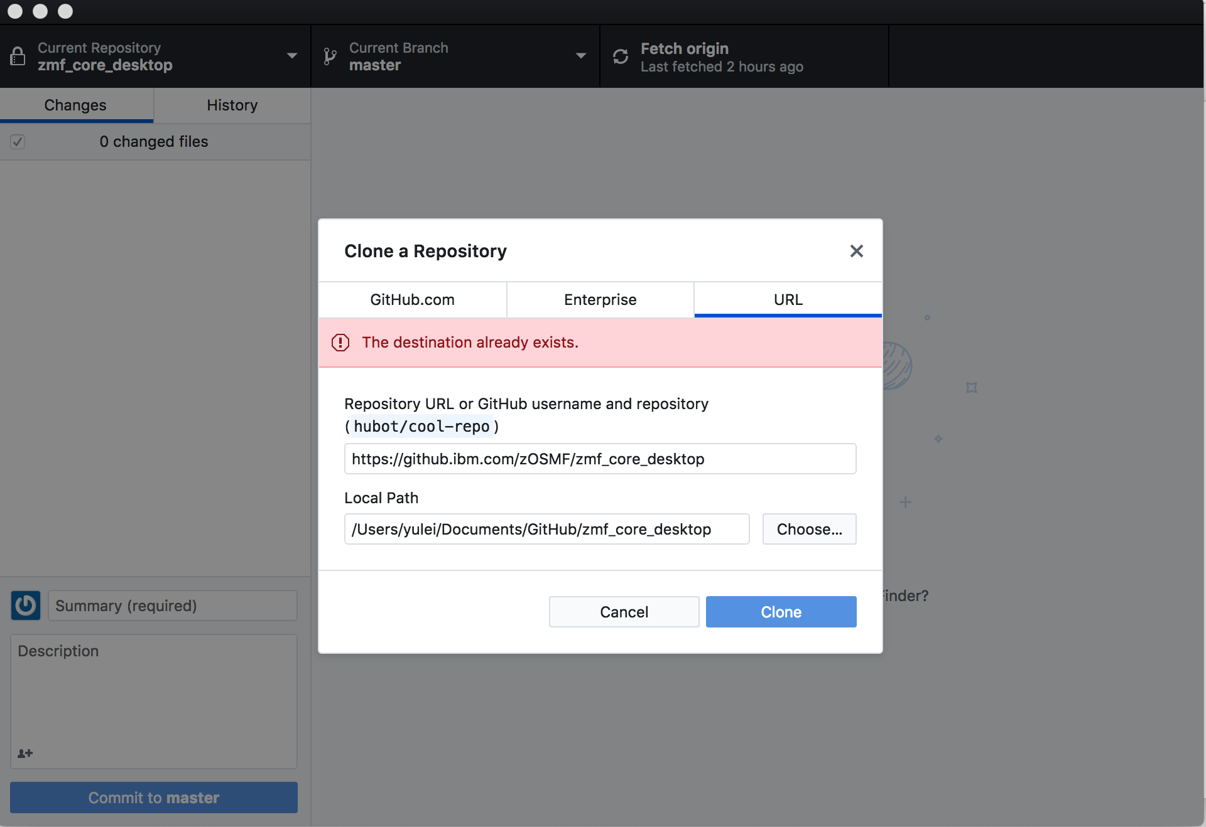
Input source link as below, you will get the source in zmf_core_desktop

Slide 10
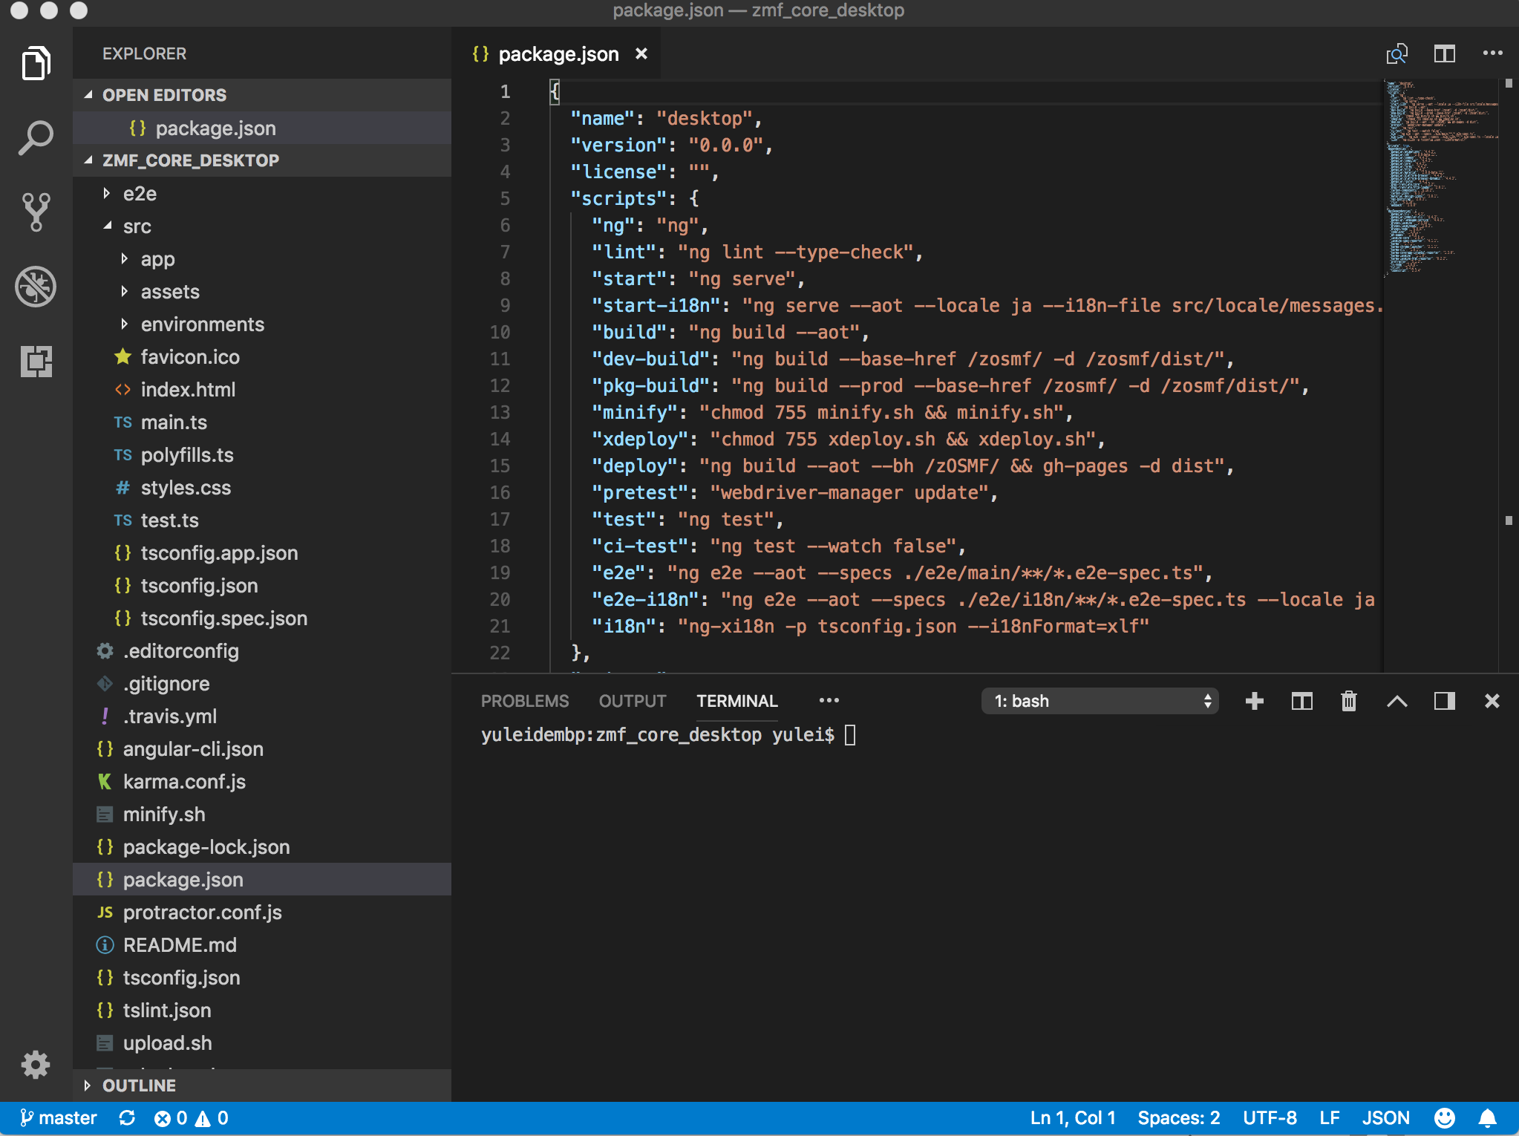
Download visual studio code from O2O

Slide 11
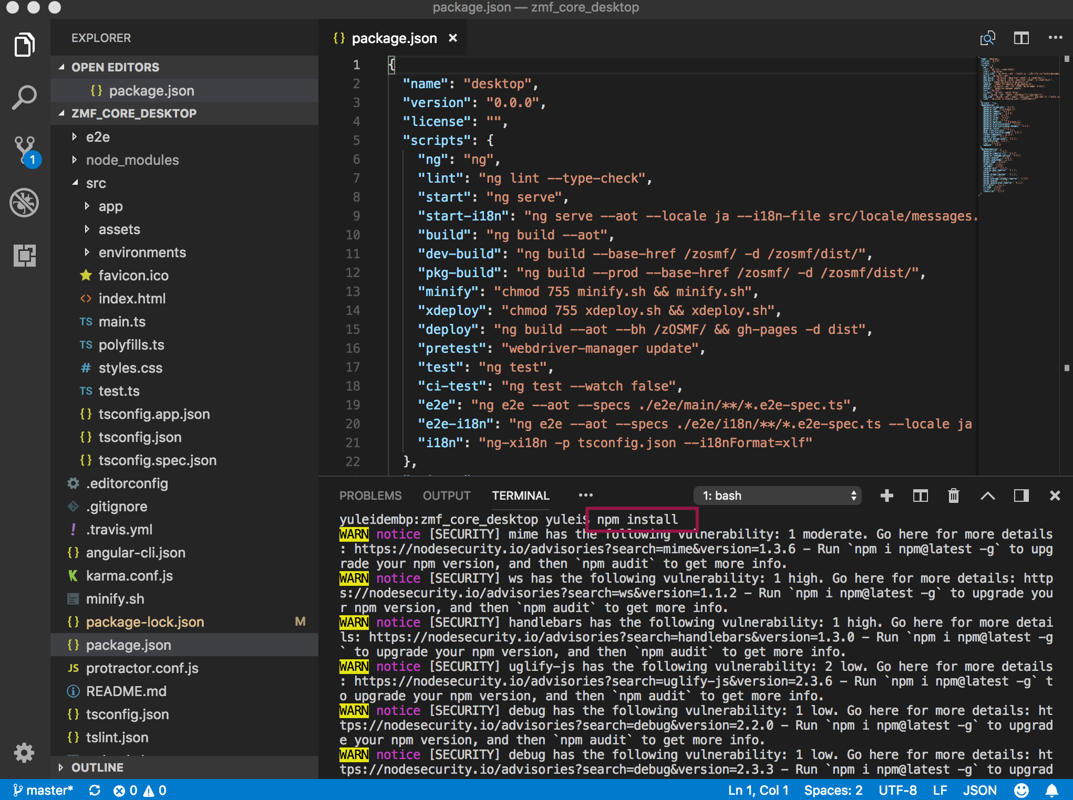
Use npm install to setup env

Slide 12
Install nodejs from IBM website
https://na.artifactory.swg-devops.com/artifactory/webapp/#/home

Slide 13
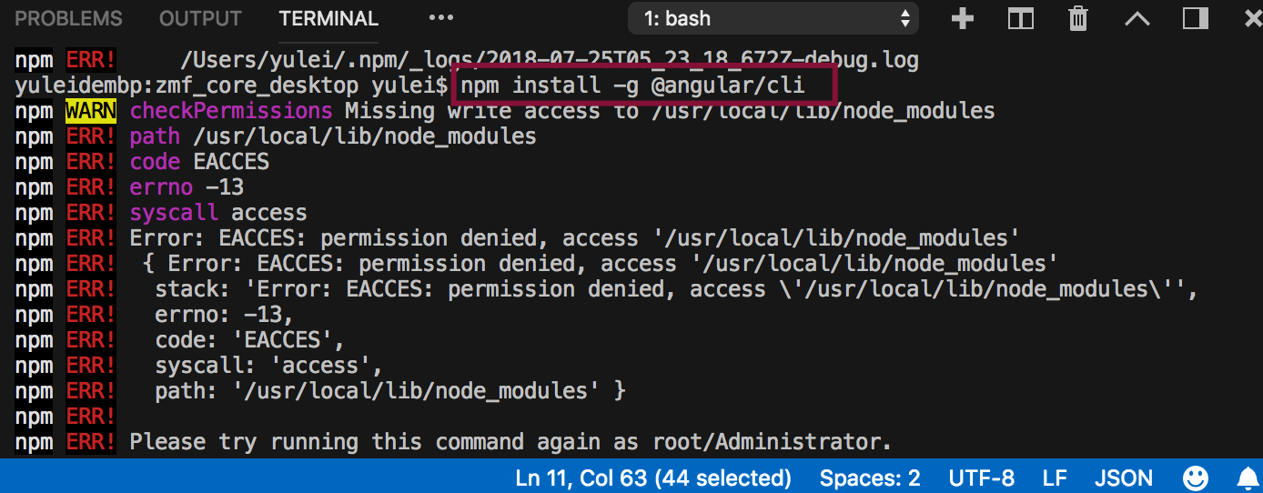
Install angular -1
If you meet this problem, change directory owner to your current user as below in your terminal:

Slide 14
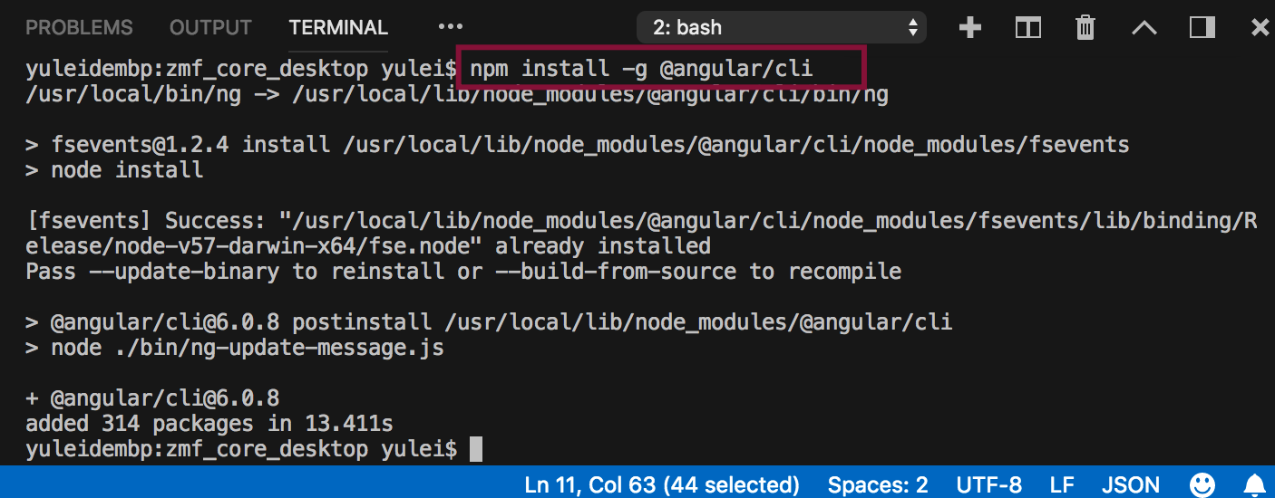
Install angular -2
Notes:
Comments from YuanY:
Check version，run
ng v
Error Could not find module “@angular-devkit/build-angular” happen, run
npm install --save-dev @angular-devkit/build-angular

Slide 15
z/OSMF Environment Setup

Slide 16
Load source code, I used hsma230spe_int

Slide 17
Select the following projects, we should select 11 ones.

Slide 18
After source code loaded, see the migration panel, then click cancel

Slide 19
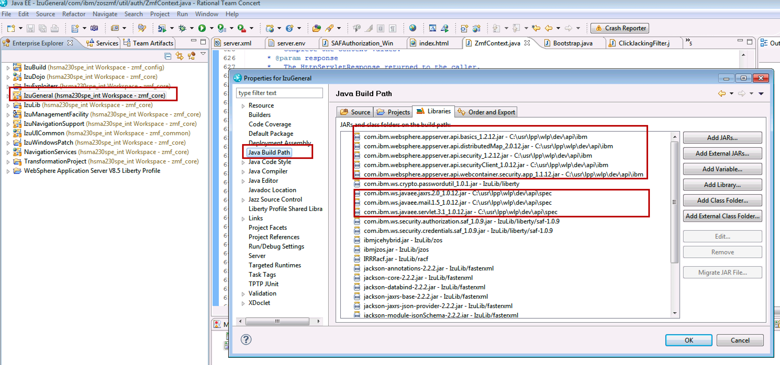
Clear IzuGeneral errors, add the following jar files as below:

Slide 20
Clear NavigationServices errors, add the following jar files as below:

Slide 21
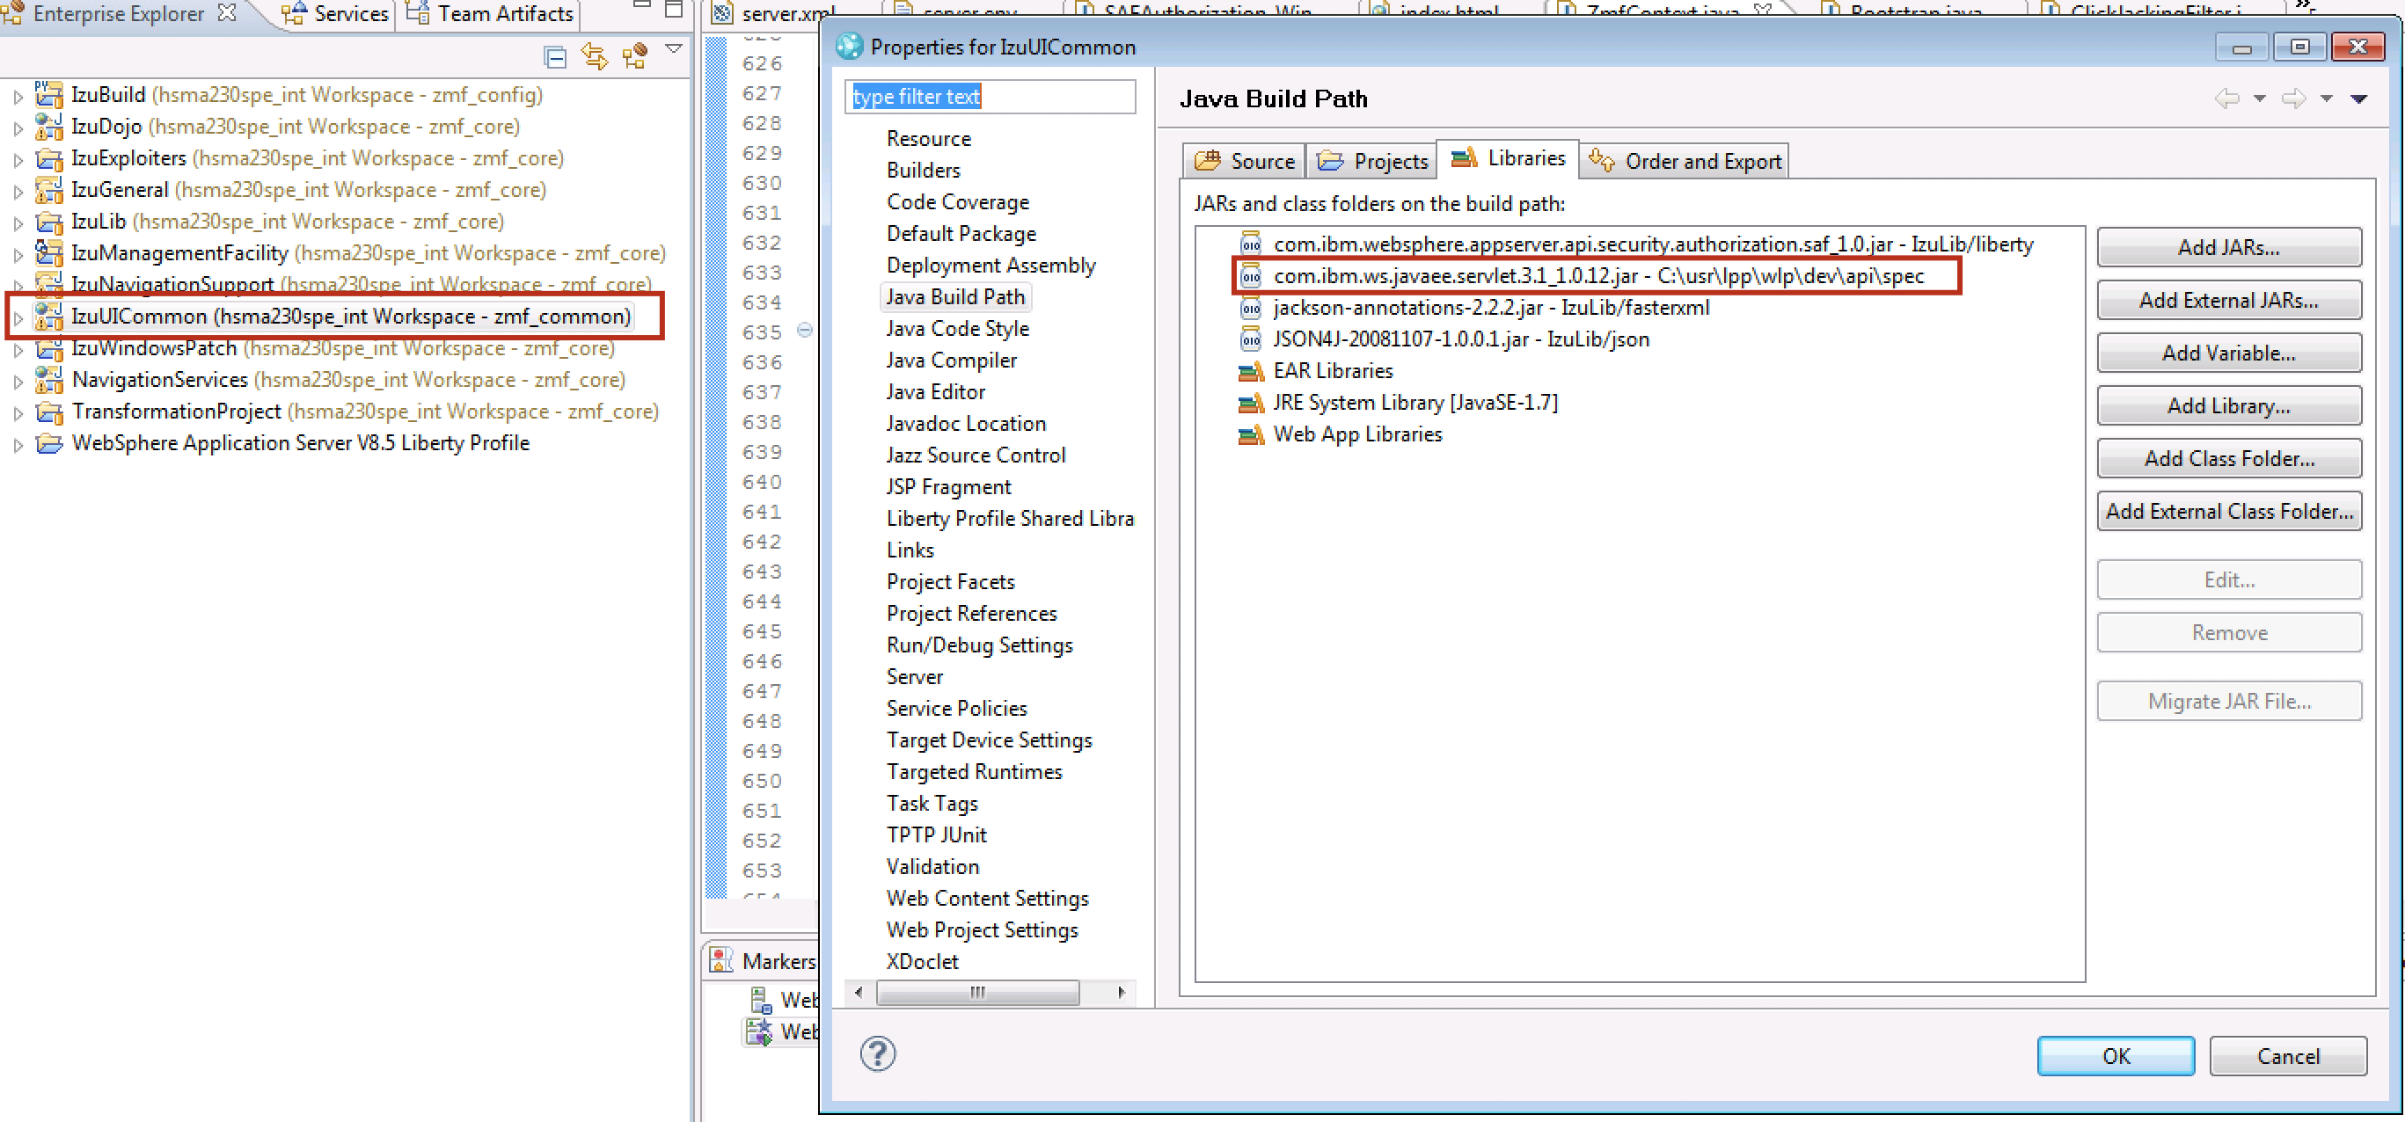
Clear IzuUICommon errors, add the following jar file as below:

Slide 22
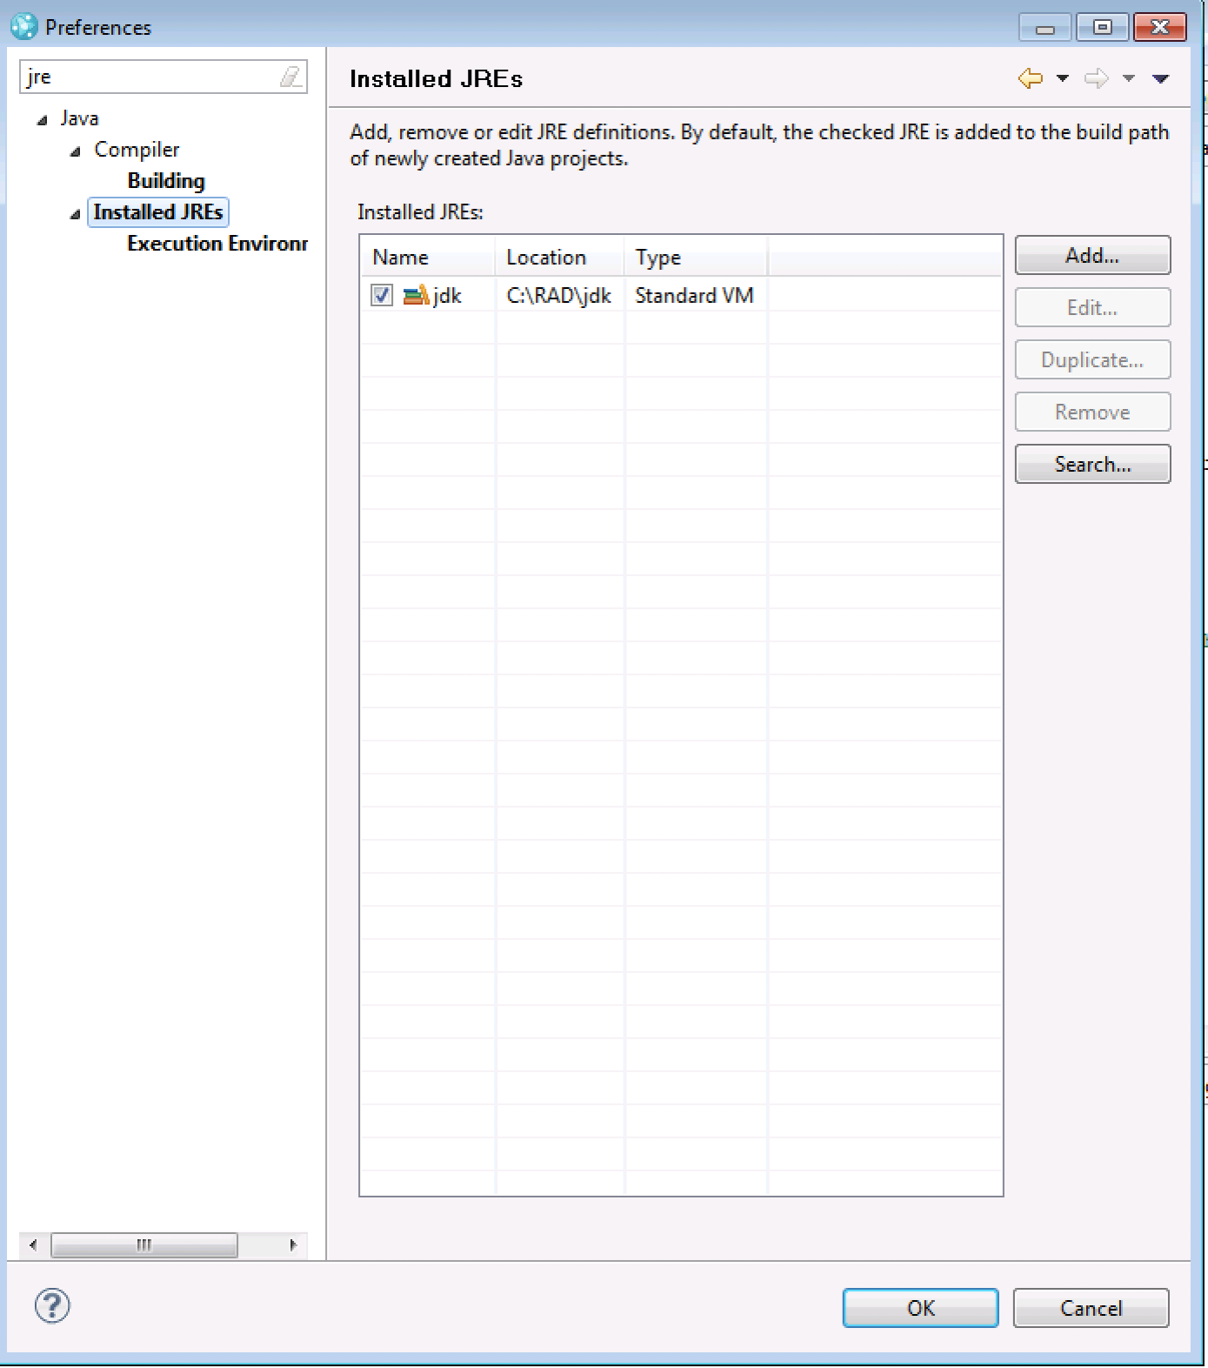
Configure JRE as below:

Slide 24
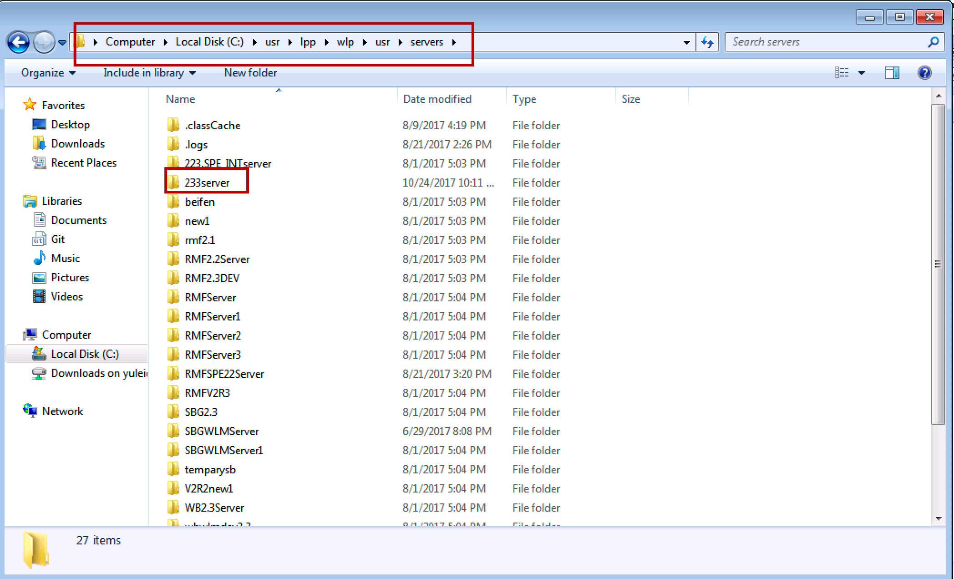
Configure Runtime

Slide 25
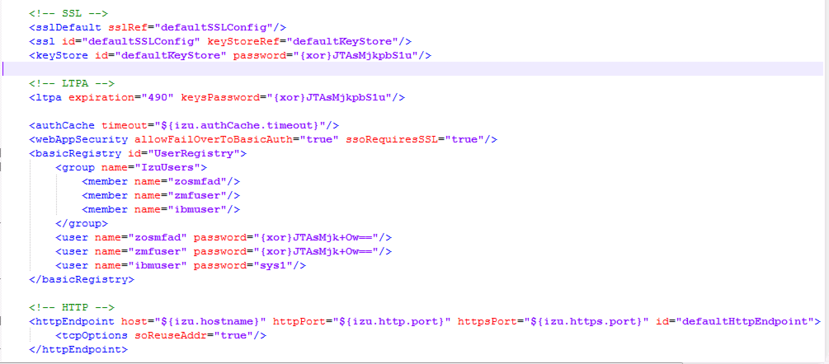

Slide 26
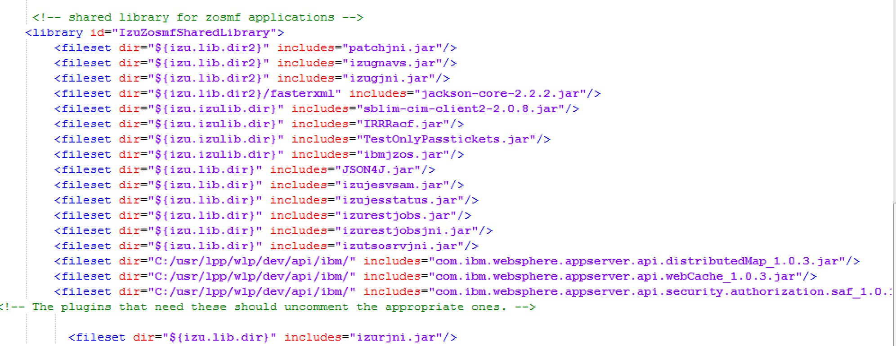
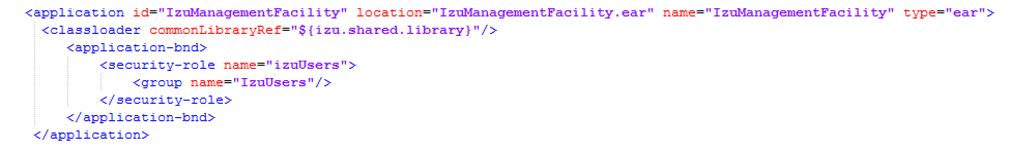
Notes:
Comments from YuanY:
1. check below jars in IzuZosmfSharedLibrary
<fileset dir="${izu.lib1.dir}" includes="jackson-annotations.jar" />
<fileset dir="${izu.lib1.dir}" includes="jackson-core.jar" />
<fileset dir="${izu.lib1.dir}" includes="jackson-databind.jar" />
<fileset dir="${izu.lib1.dir}" includes="jackson-jaxrs-base.jar" />
<fileset dir="${izu.lib1.dir}" includes="jackson-jaxrs-json-provider.jar" />
<fileset dir="${izu.lib1.dir}" includes="jackson-module-jsonSchema.jar" />
2. Chack jaxrs-1.1 in feature

Slide 27
New server from server tab

Slide 31
Remove @override in the following files

Slide 32
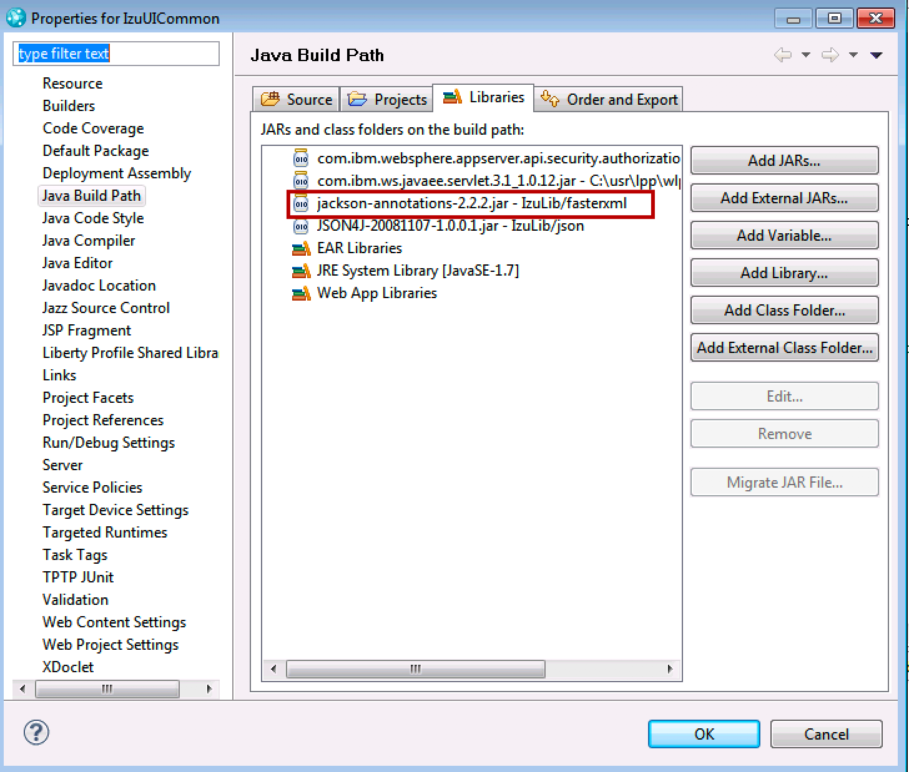
Remove annotation error in above screenshot

Slide 33
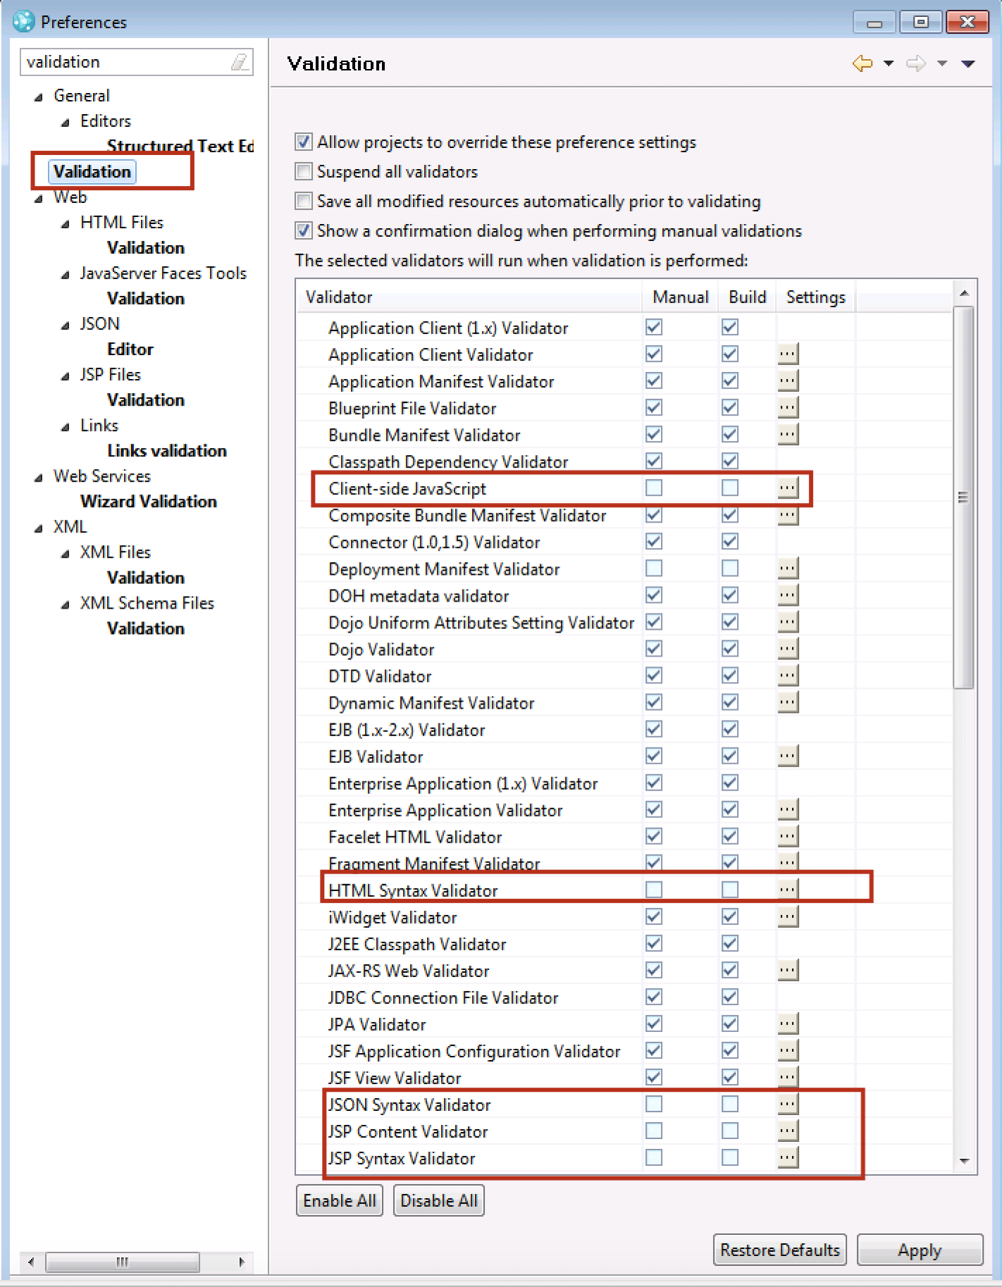
Remove other jsp errors, uncheck the following selections.

Slide 34
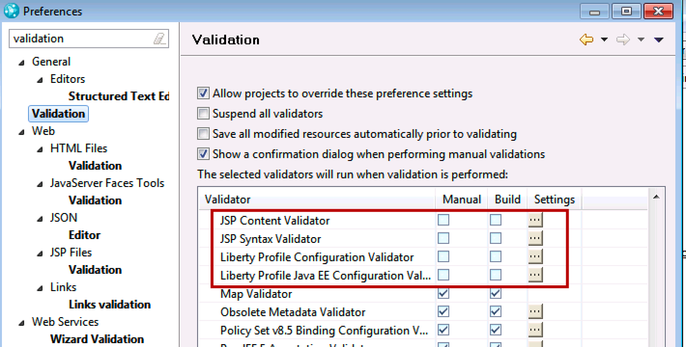

Slide 35
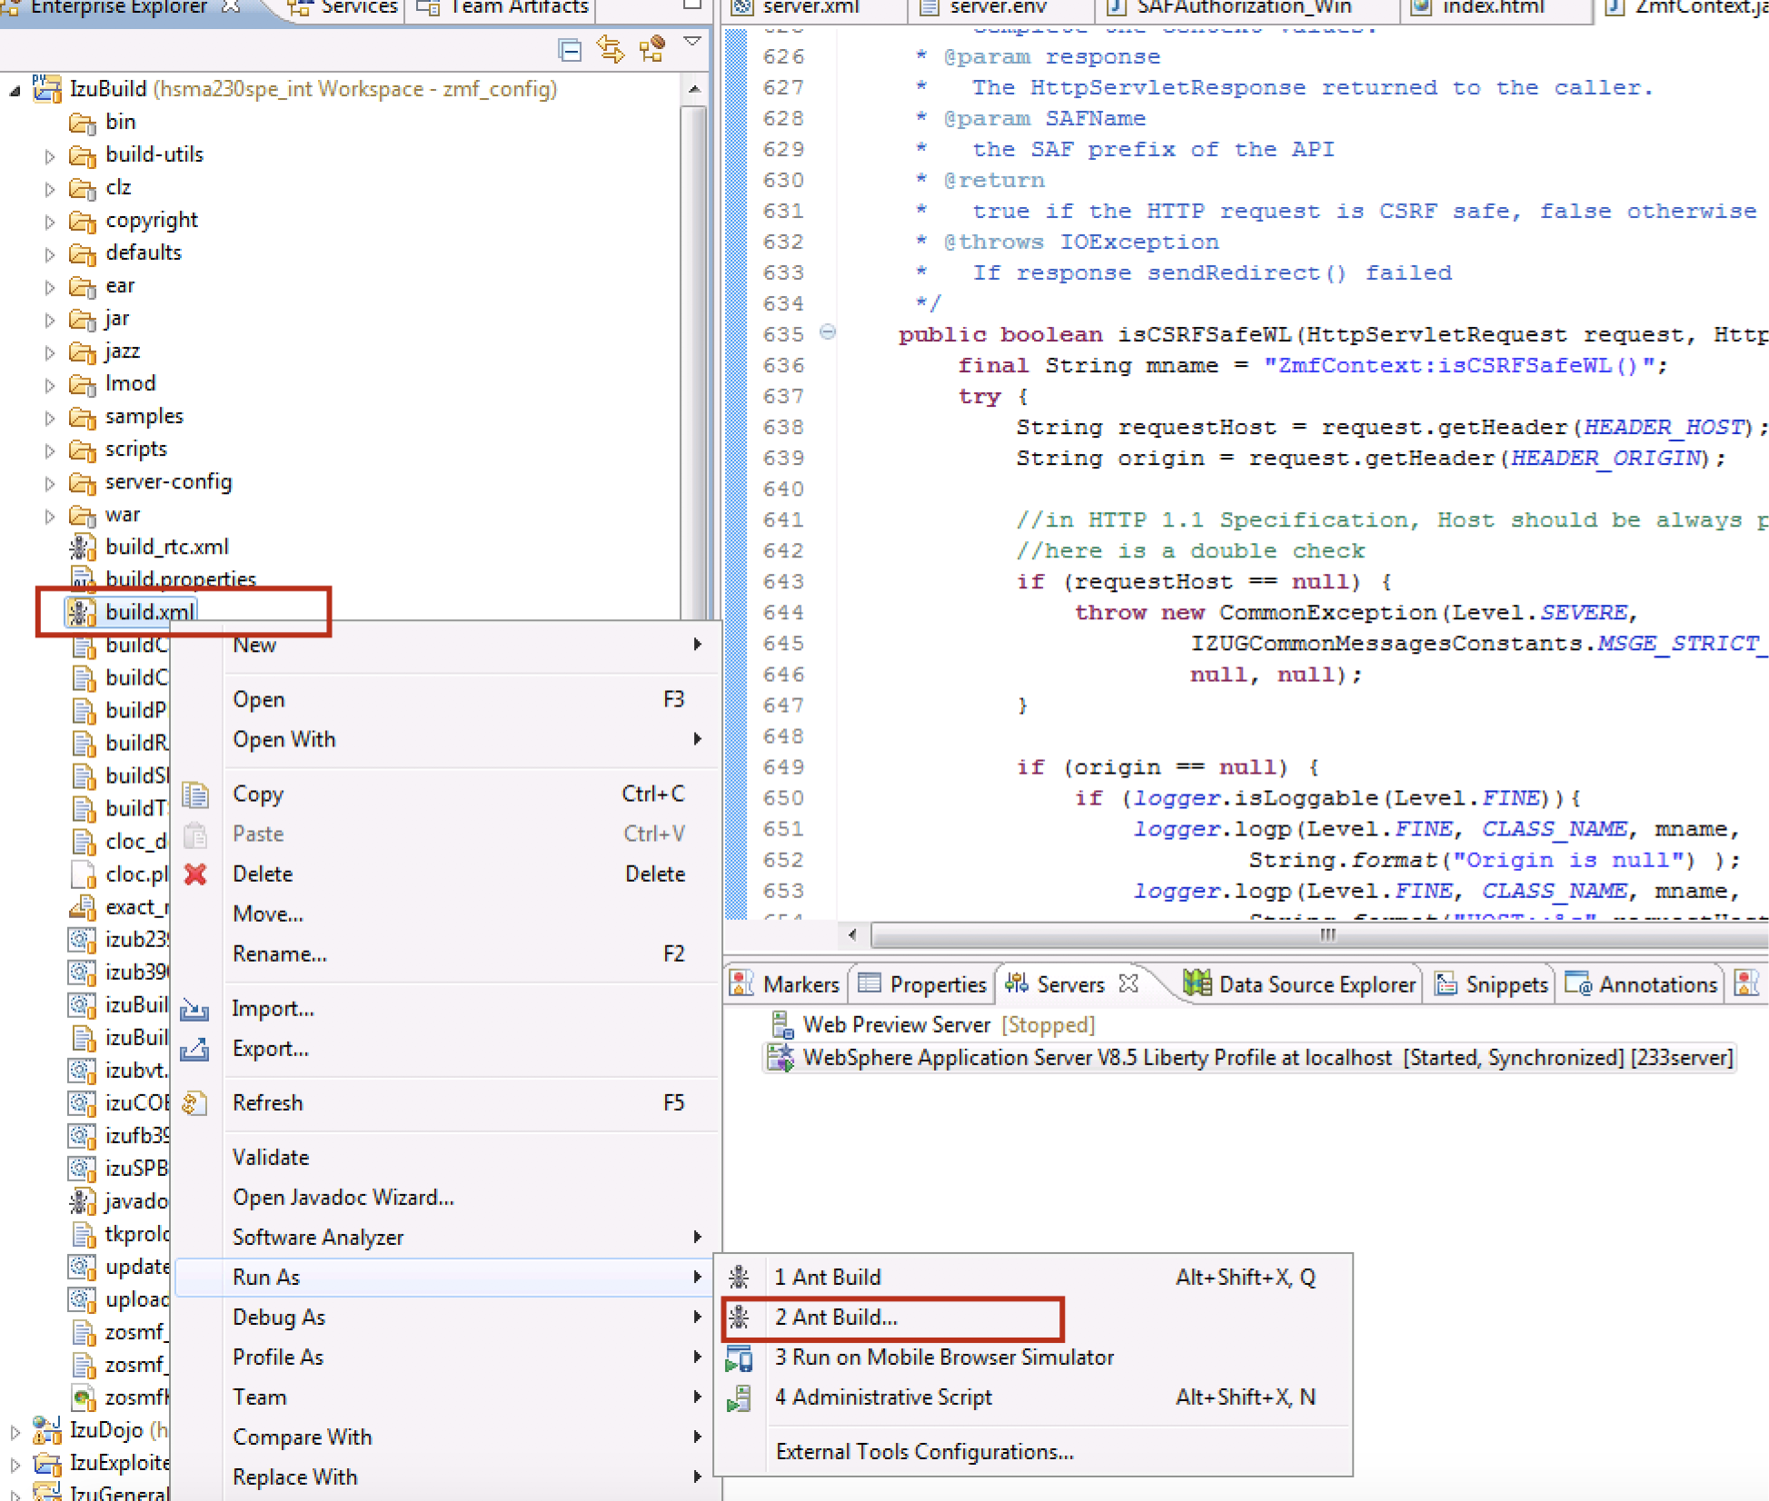
Run IzuBuild ,put my build.xml to IzuBuild project and then run as “ant build…”

Slide 36
Ant selection will be as below:

Slide 37
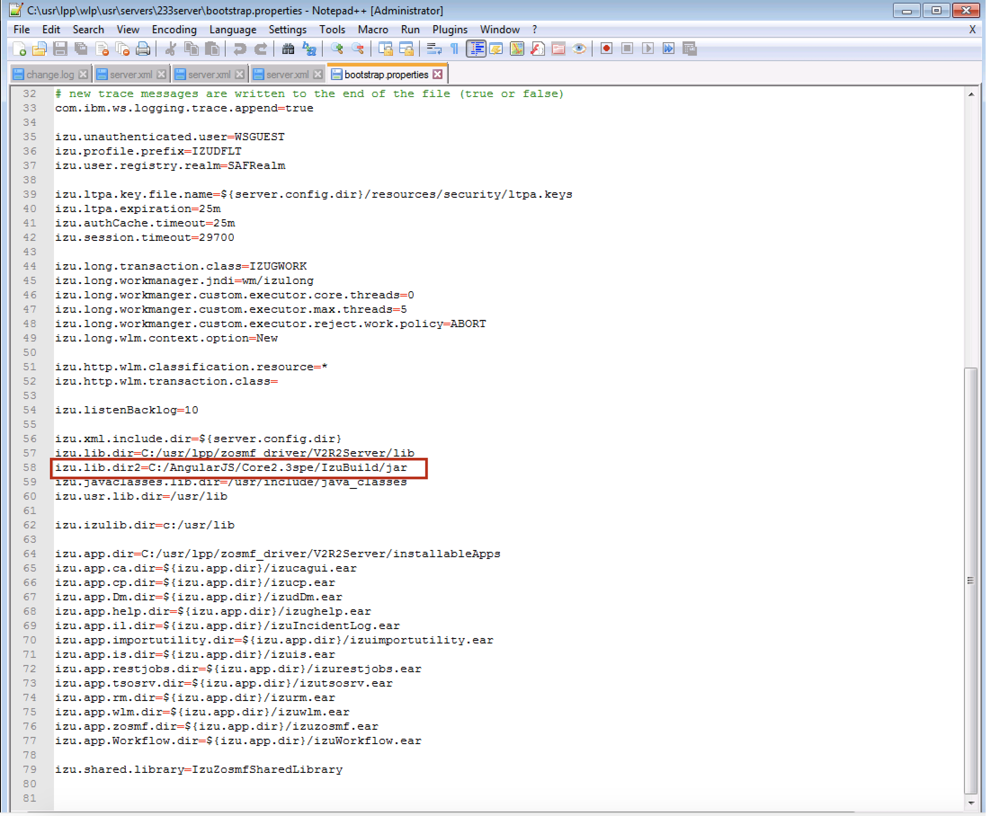
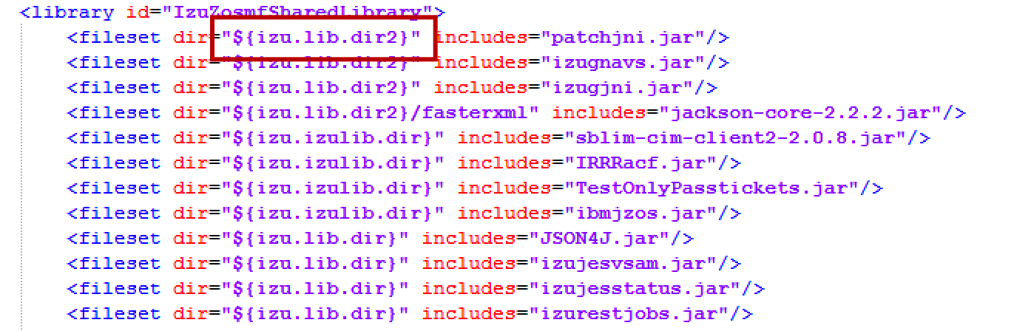
Recheck liberty server

Slide 38
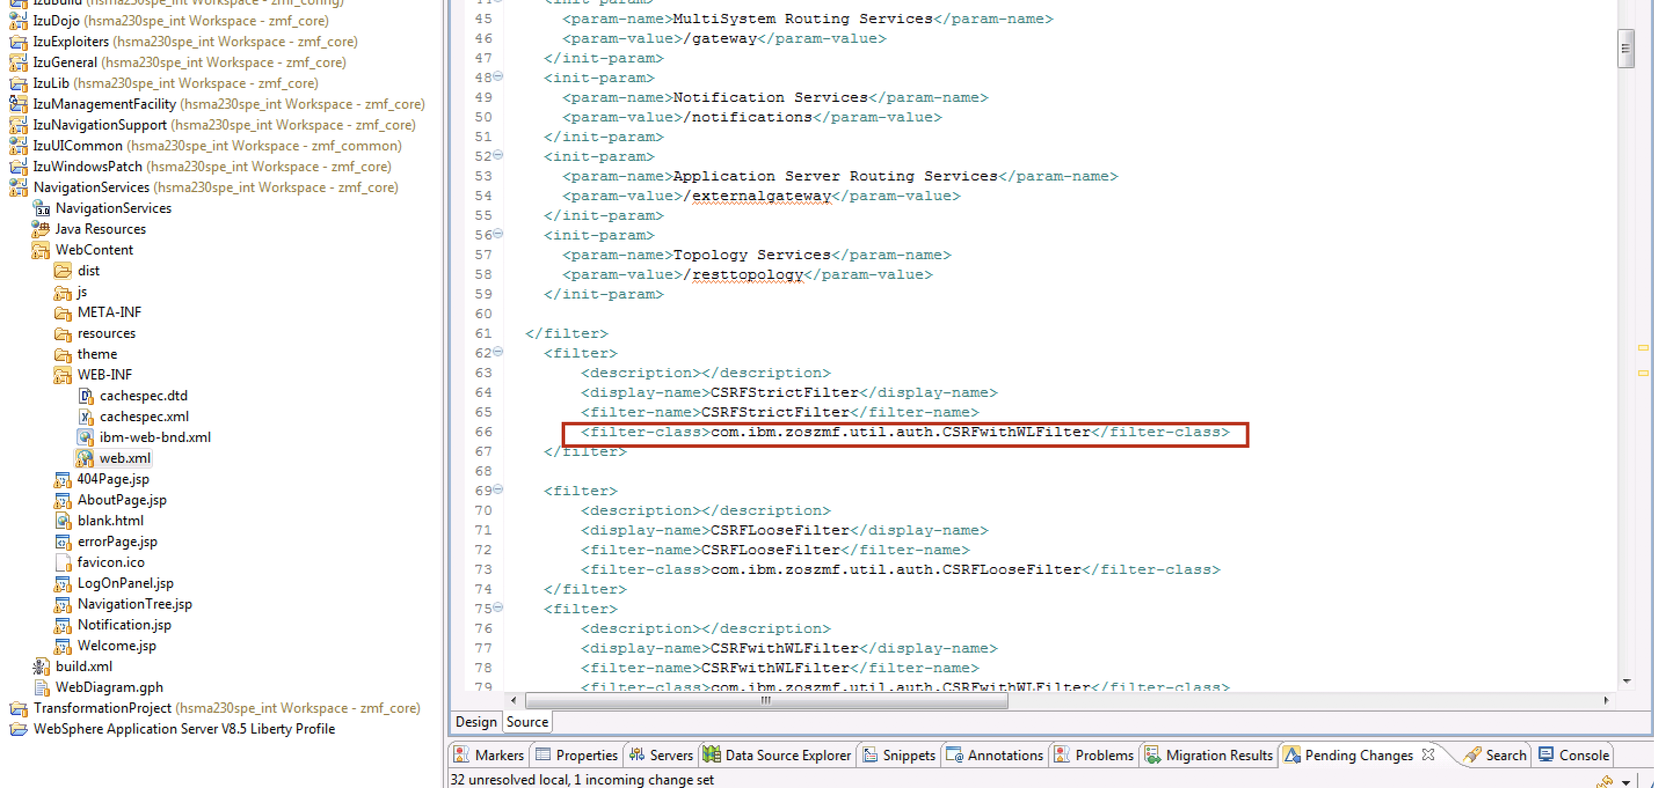
Modify web.xml as below:

Slide 39
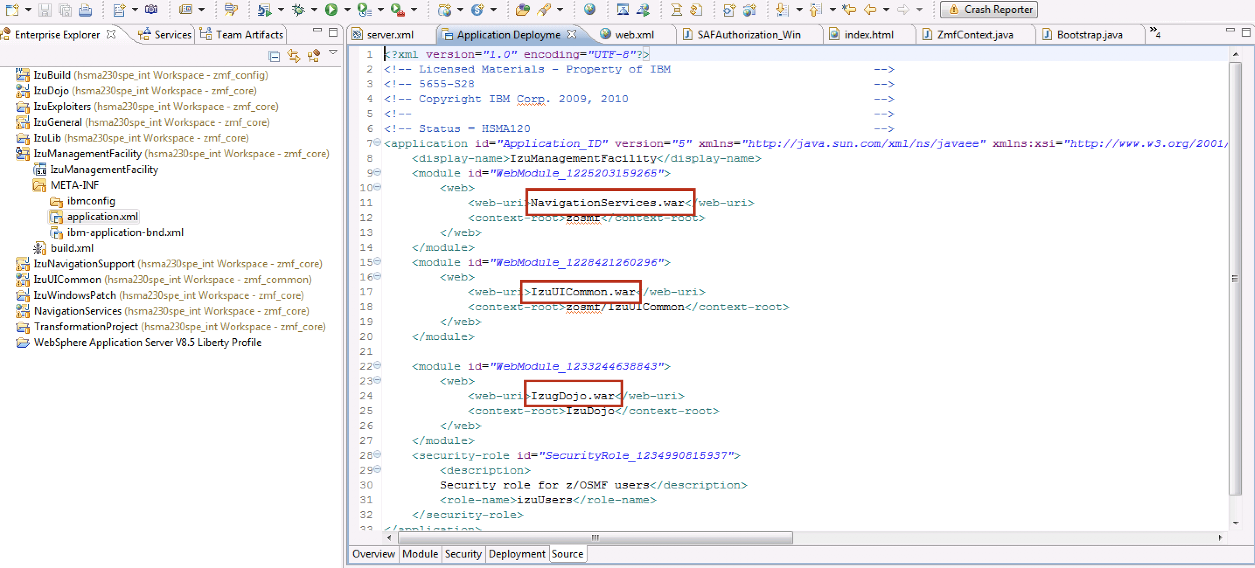
Modify application.xml
change these three war file names, make sure the local war files can be called.

Slide 40
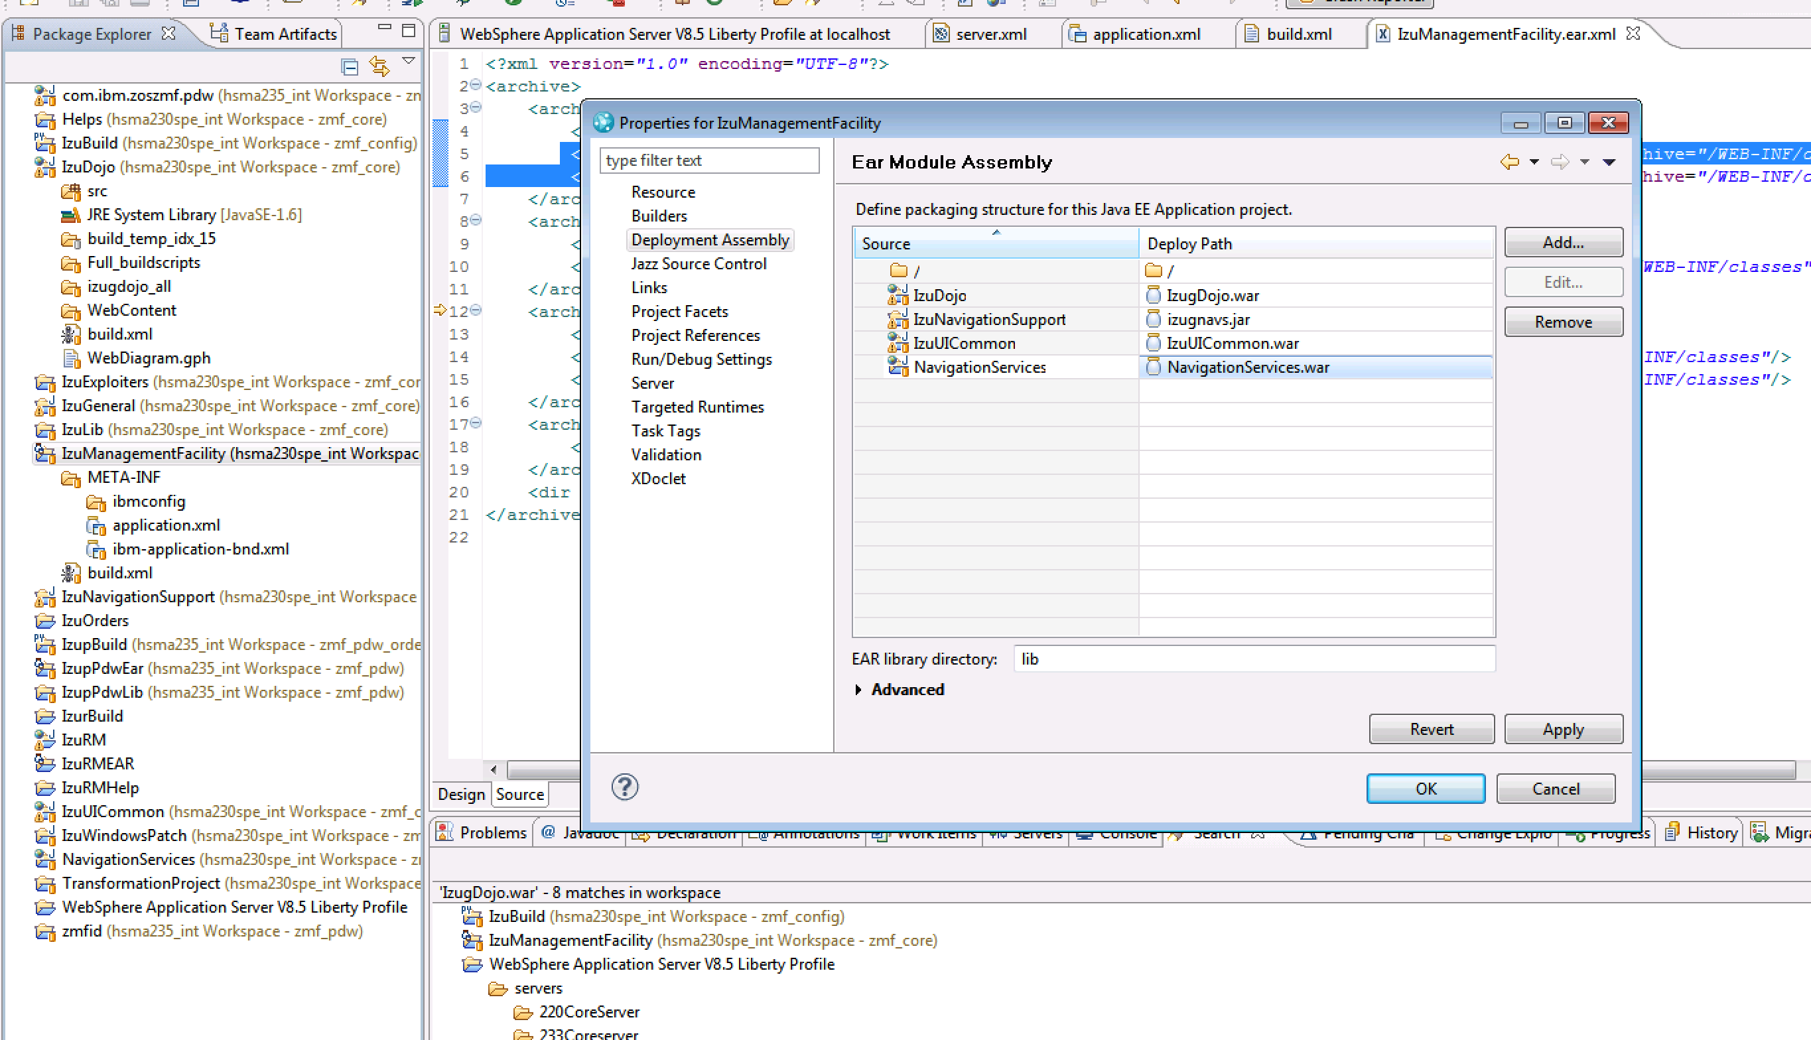

Slide 41
Integrate Angular Code to z/OSMF Environment

Slide 42
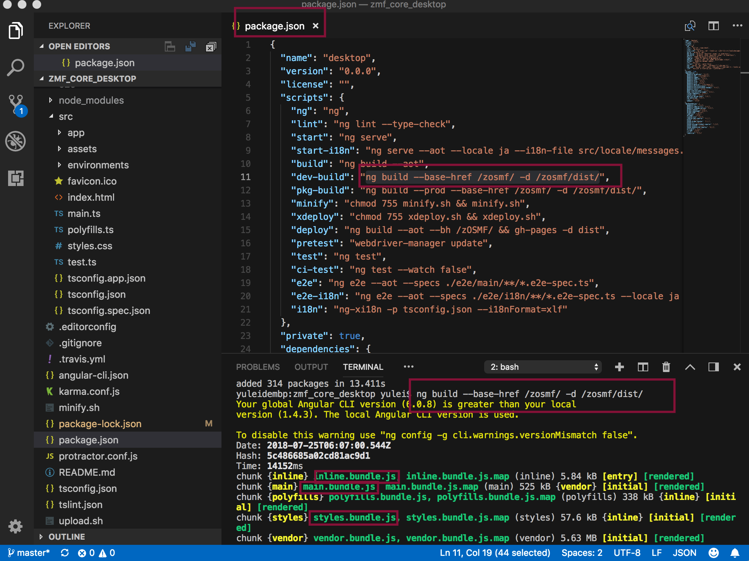
Package angular code to js code to dist folder

Slide 43
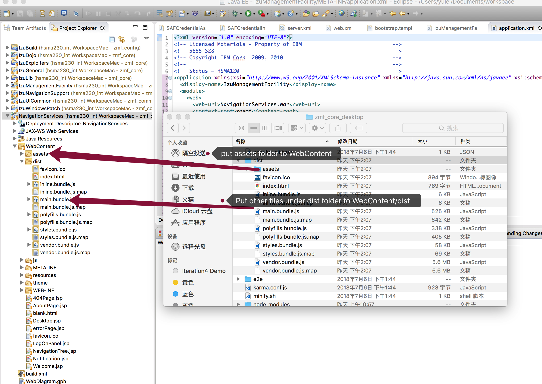
Put dist folder to z/OSMF source folder as below.

Slide 44
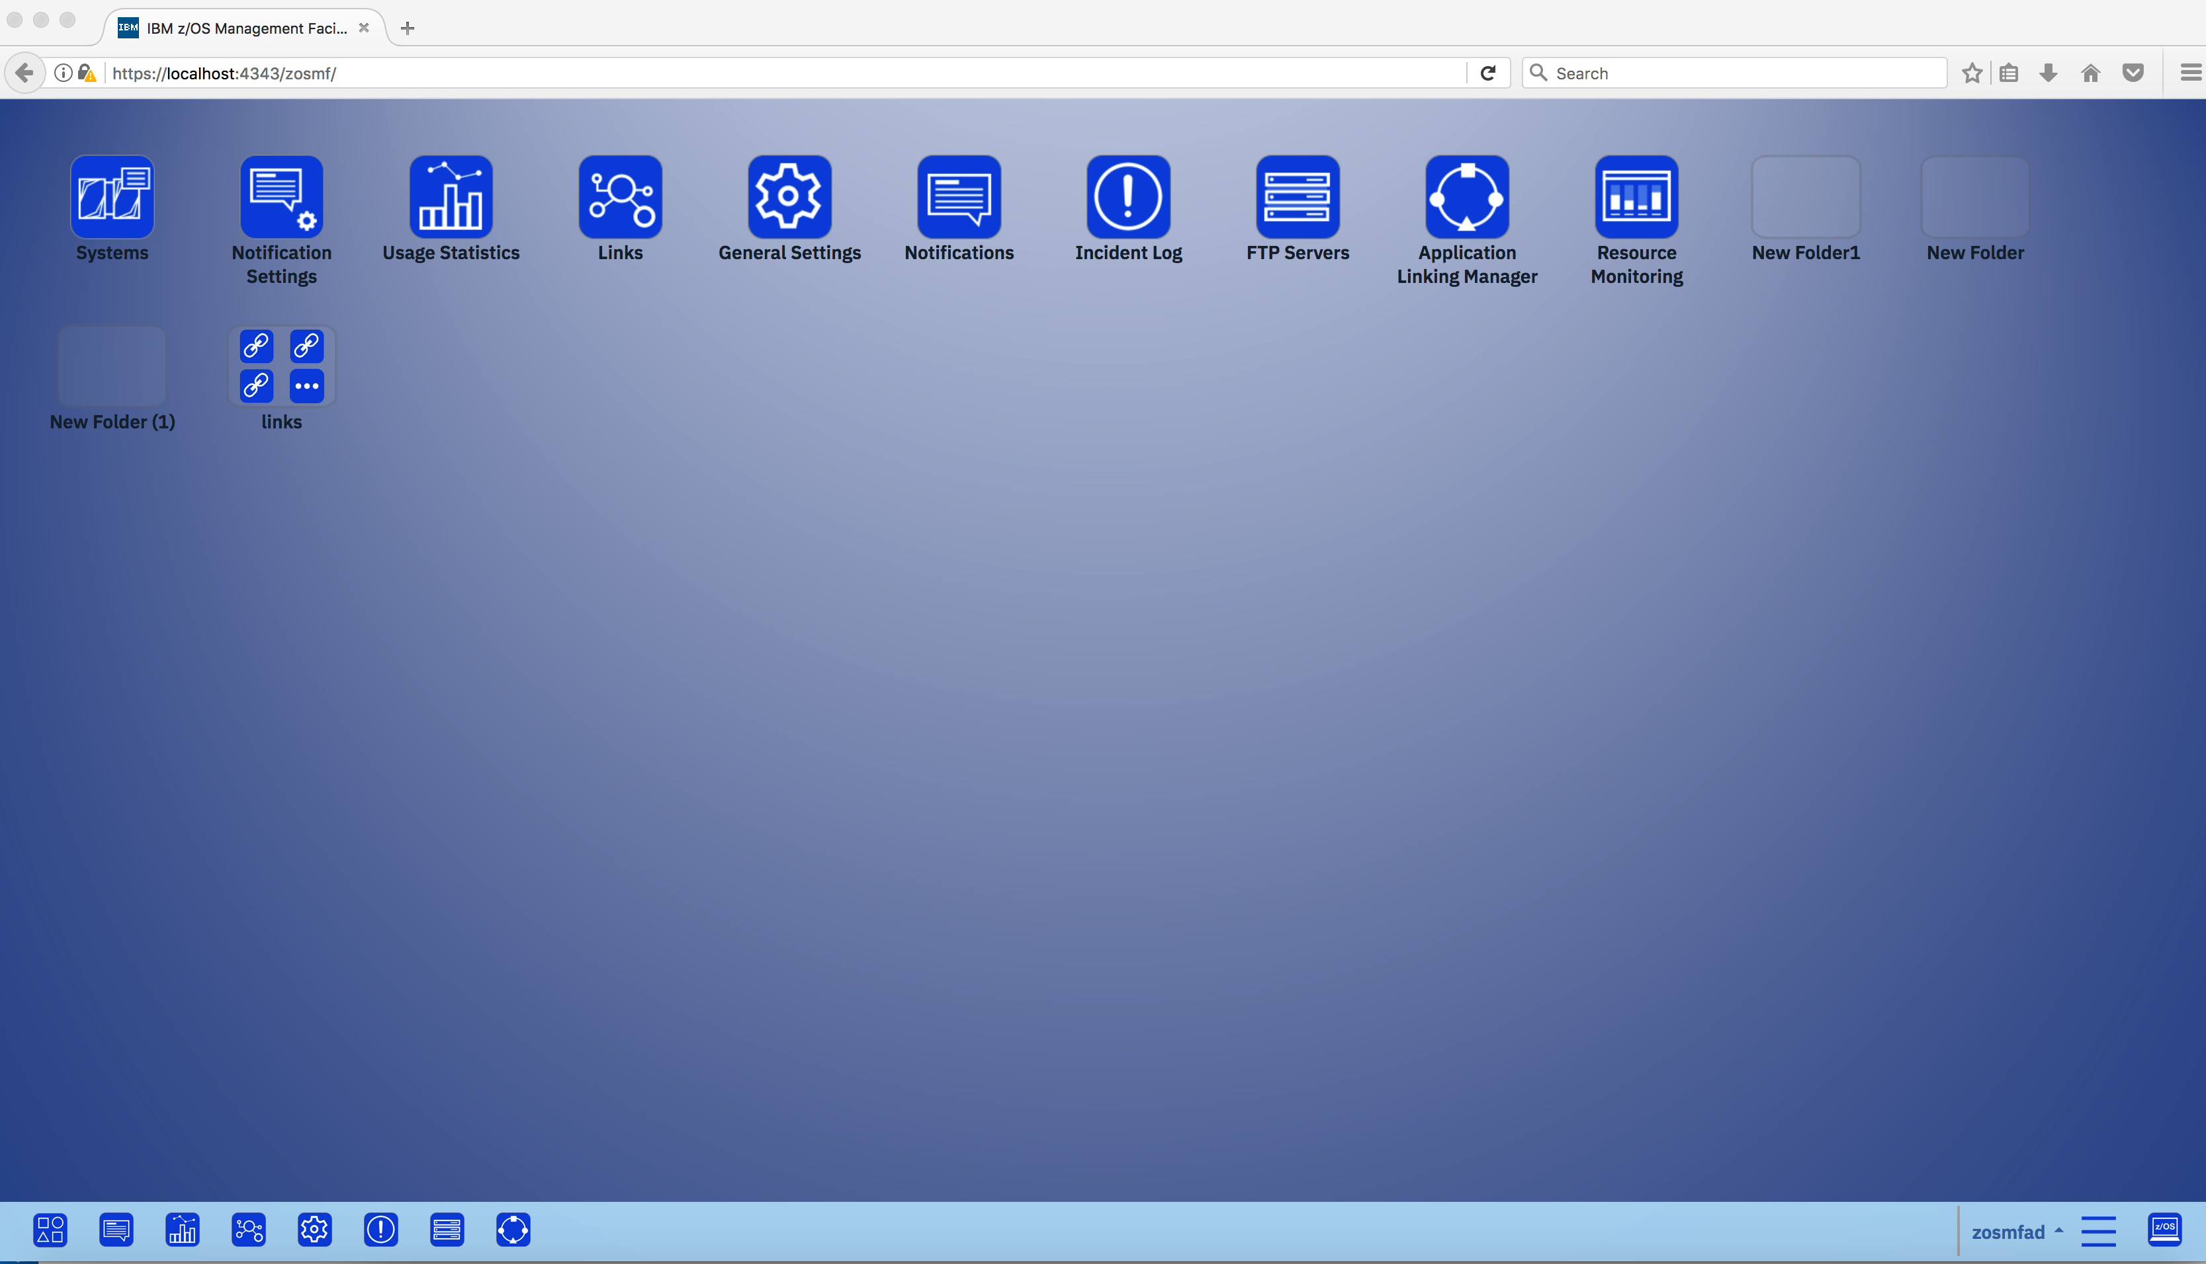
Clean project, then start z/OSMF from browser

Slide 45
Single Angular Development Environment

Slide 46
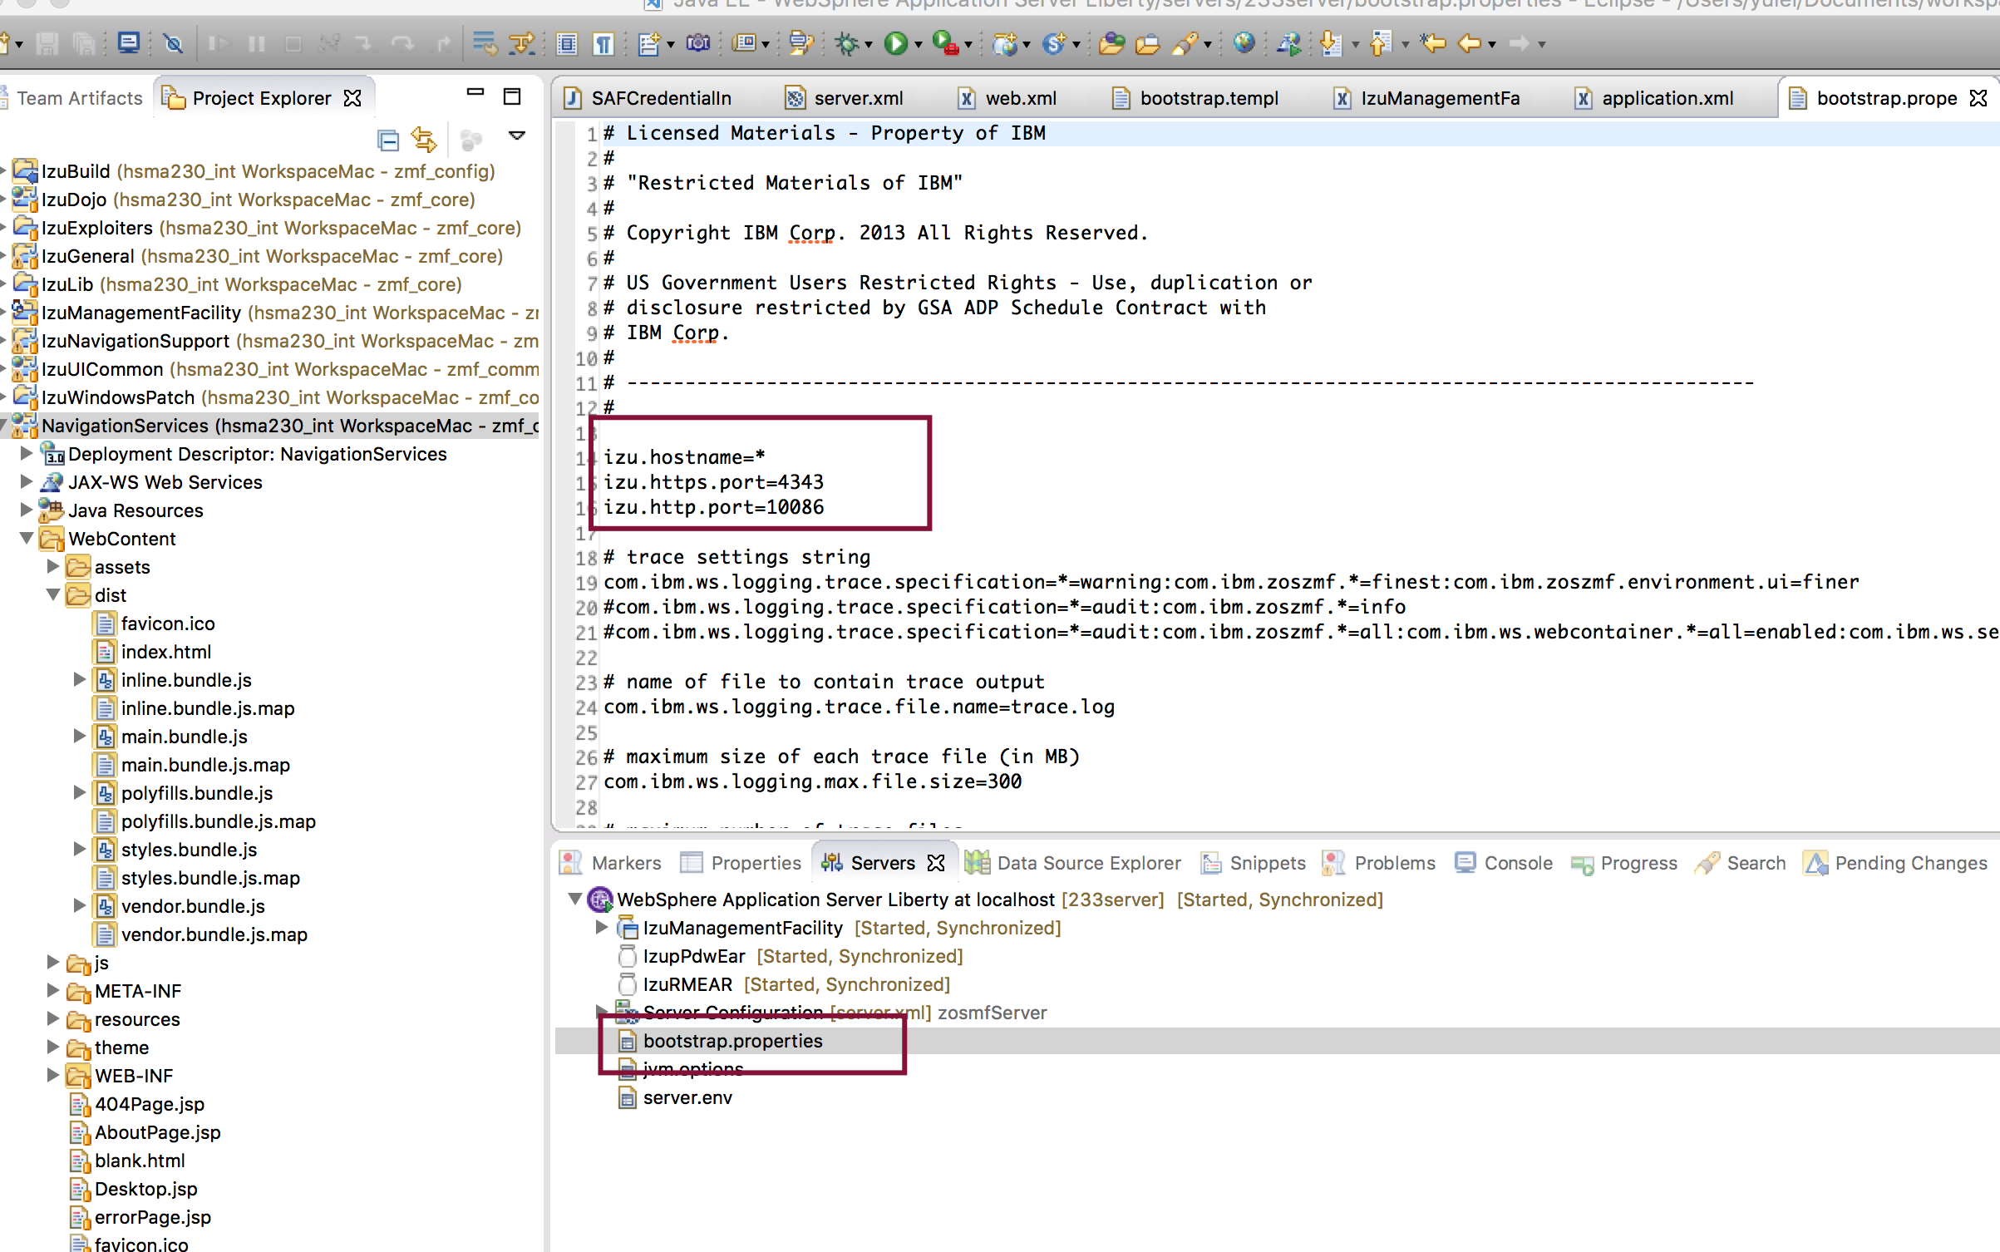
Start development env in Visual Studio Code – Check your port number in RTC

Slide 47
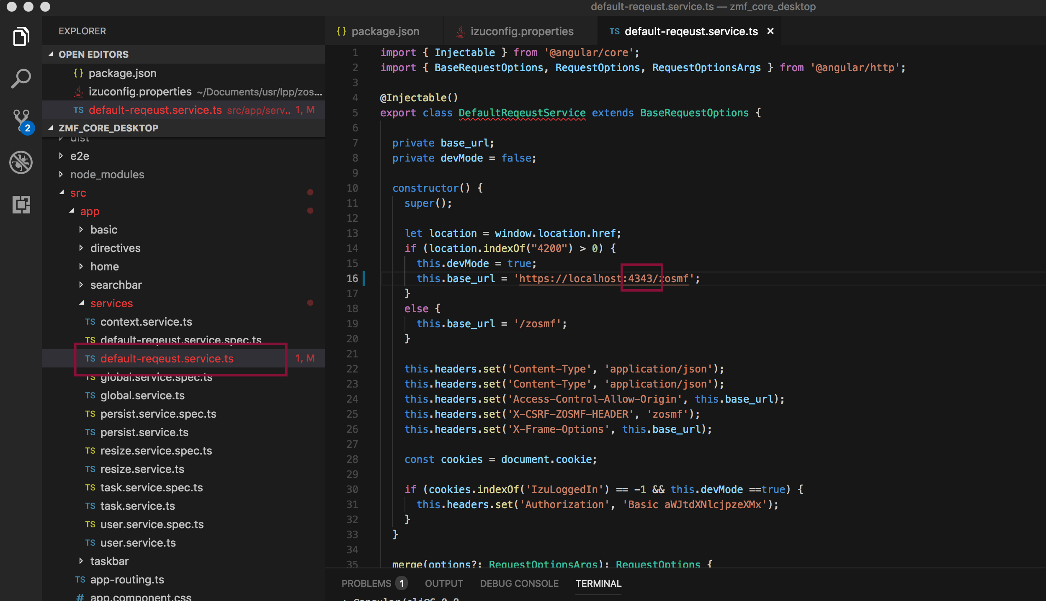
Change port in default-request.service.ts
Notes:
Code changes, now please change in “zosmf-interceptor.service.ts”

Slide 48
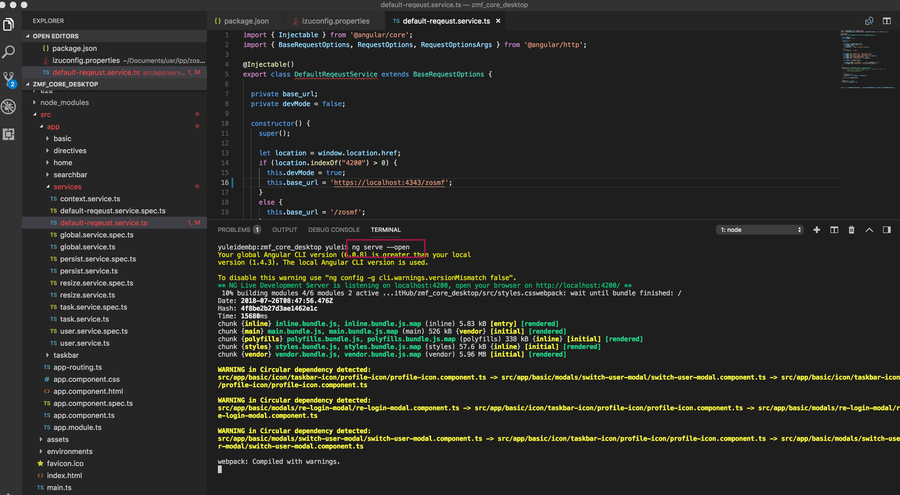
Use ng serve --open to start angular page

Slide 49
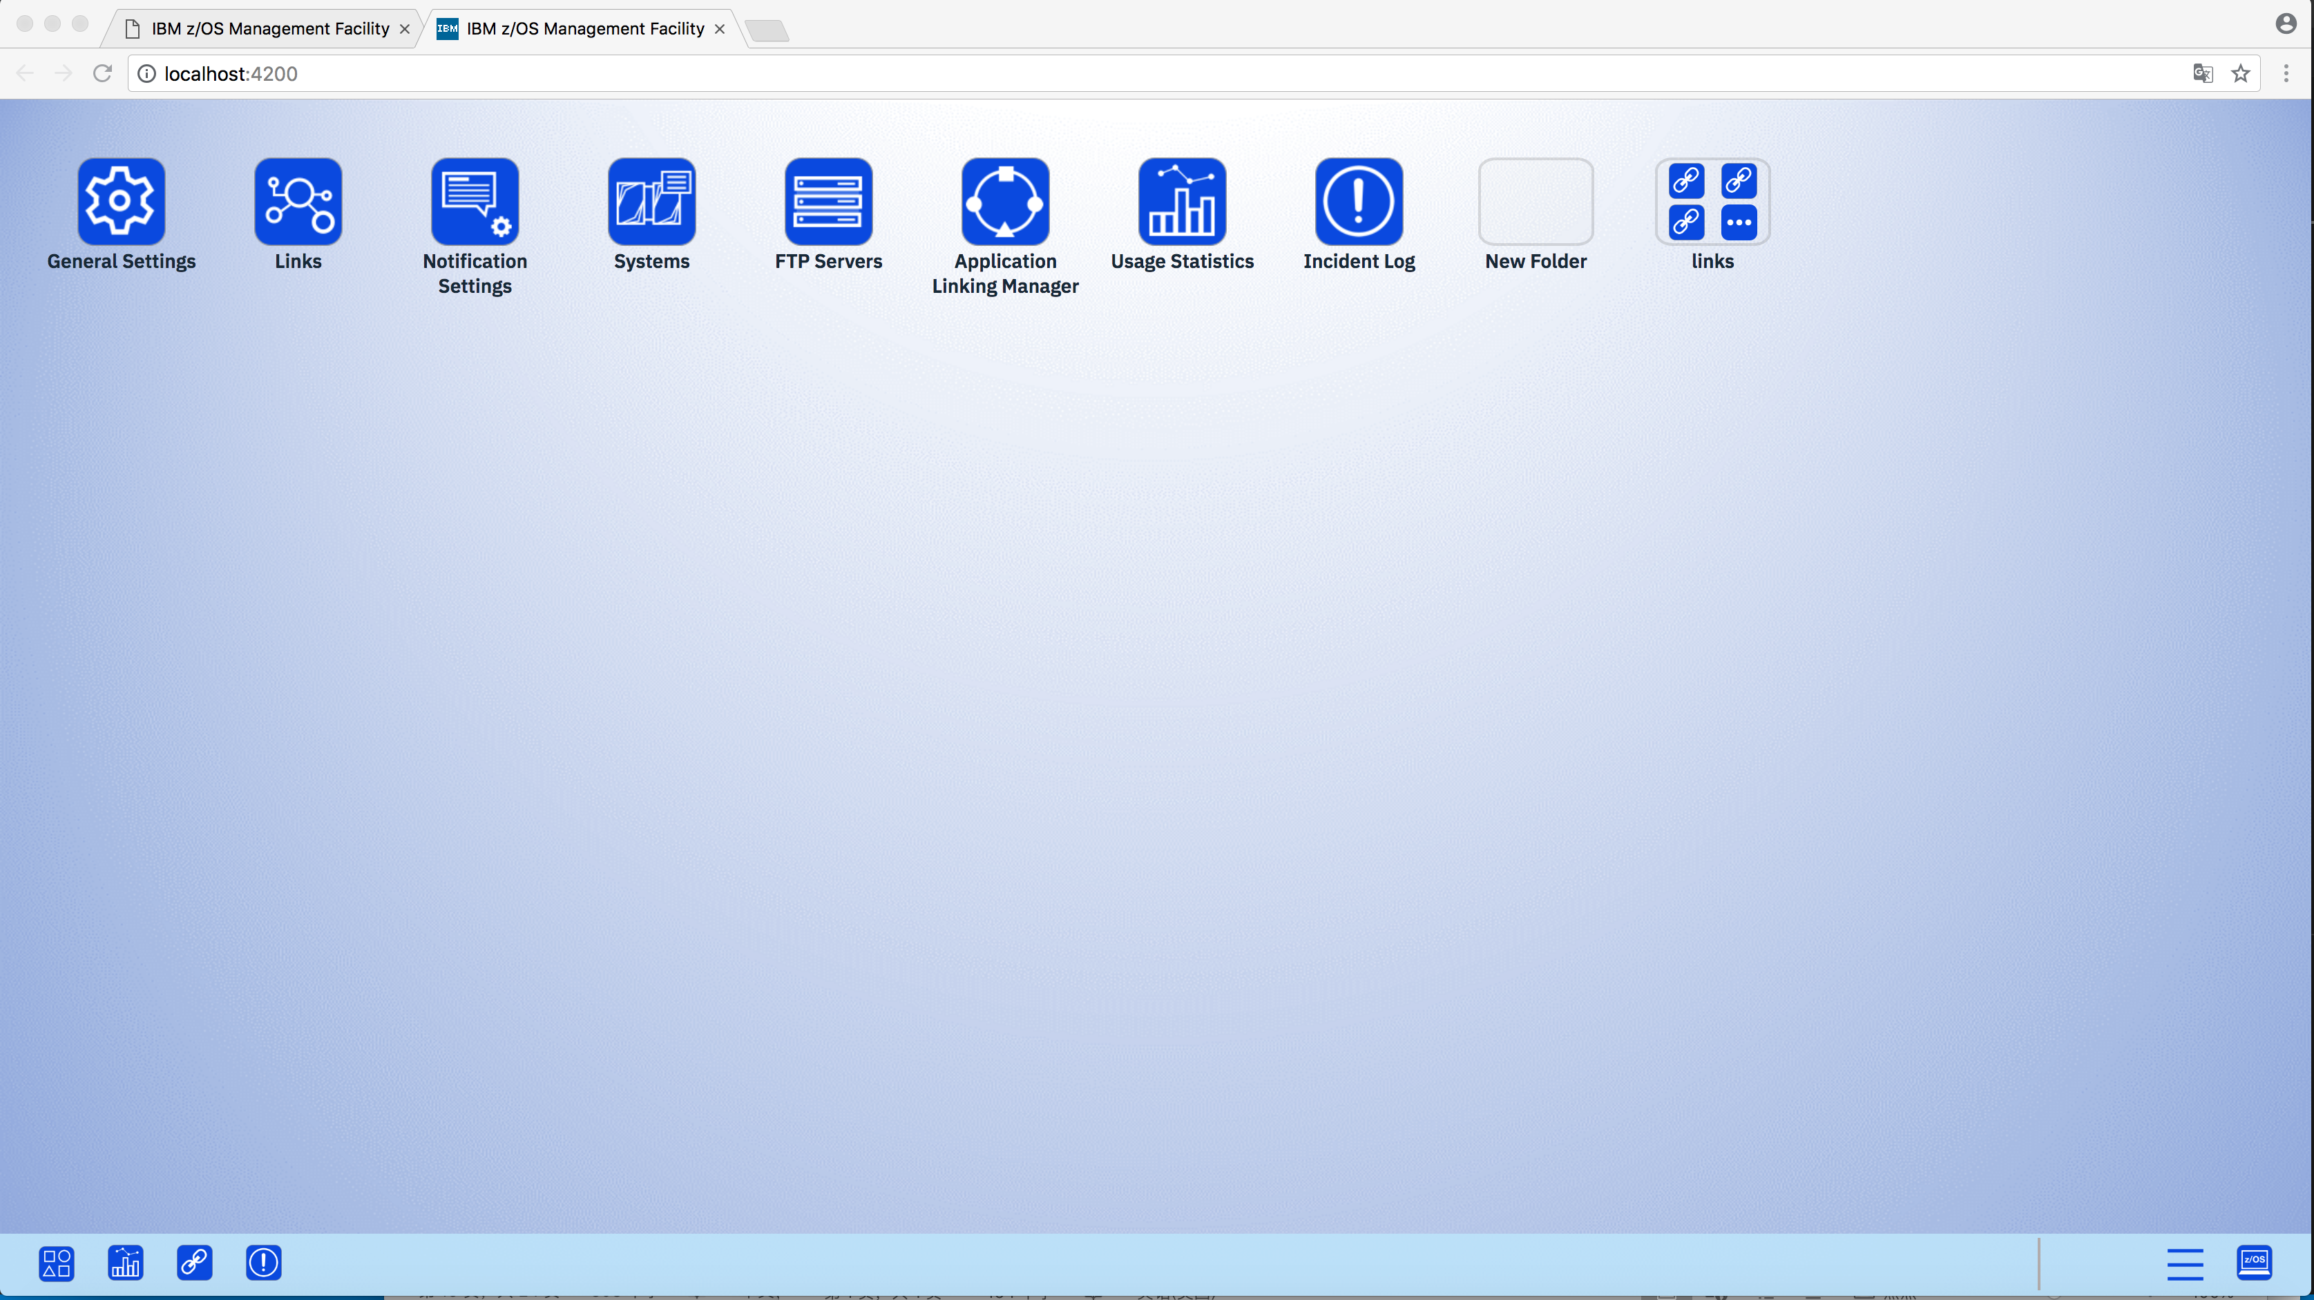
Start 4200 port, if no any icons, please login in https://localhost:4343/zosmf by userid and password, authentication is required.

Slide 50
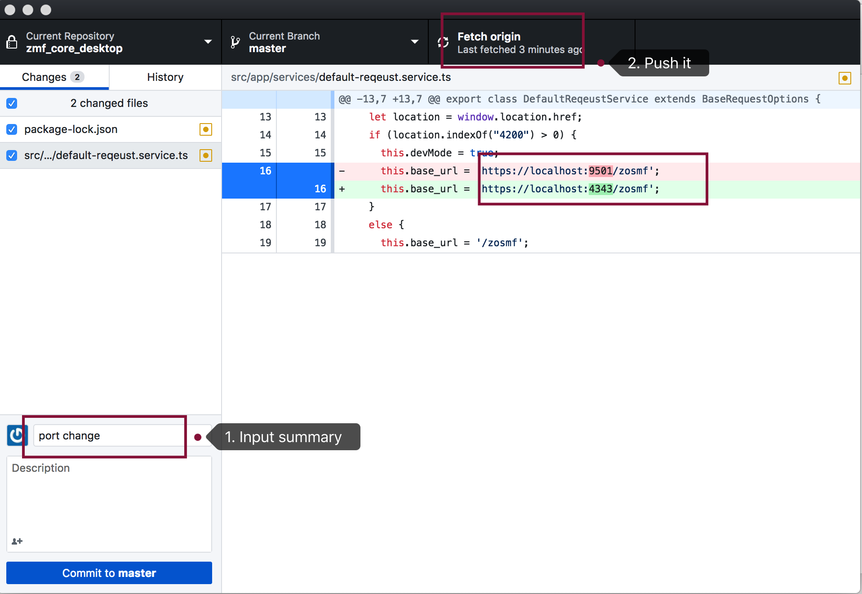
In Github desktop, the changed code will be reflected here, input summary in step 1, then click push in step 2.

Slide 51
End

Slide 52
ng g c heroes/hero-list
ng g s heroes/hero-service
<app-logmng-list></app-logmng-list>
Specify the module using the --module parameter. For example, if the main module is app.module.ts, run this:
ng g c new-component --module app Or if you are in an other directory then
ng g c component-name --module ../
ng g c checkbox-list --module app

Slide 53
build
Angular+travis
Add .travis.yml(which used package.json and xdeploy.sh) in your repository
Settings your repository in https://travis.ibm.com
Start build
(build will auto execute when you code delivered once configured well).
Check file in plpsc bldzmf/i2muser2 or see info in xdeploy.sh

